Slide 1
Sound Cards and Serial Ports in Linux
Ion Todirel
5/1/2024

Slide 2
Project

Slide 3
Motivation
Scriptable query of sound cards and serial ports
Scriptable soundcard volume control and test
Reliable sound card and serial port search and mapping
Full unattended automation
Notes:
Searching for sound cards is not easily scriptable
Volume control on a per channel setting is not possible with CLI tools
Testing volume control not easy to do with existing tools
Finding one of many sound cards with non-unique/empty descriptors
udev rules limited in a multi device world and require system modifications

Slide 4
Capabilities
Enumerating sound cards
Enumerating serial ports
Sound card volume enumeration and control
Mapping serial ports to sound cards
Mapping sound cards to serial ports
Printing to stdout and to JSON
Search from command line or via a JSON configuration file

Slide 5
Project Information
Github: https://github.com/iontodirel/find_devices
Written in: C++ 20
Build system: CMake
Package Manager: FetchContent, apt
License: MIT
Platforms: Linux
LOC: 3,800

Slide 6
Scripting example

Slide 7
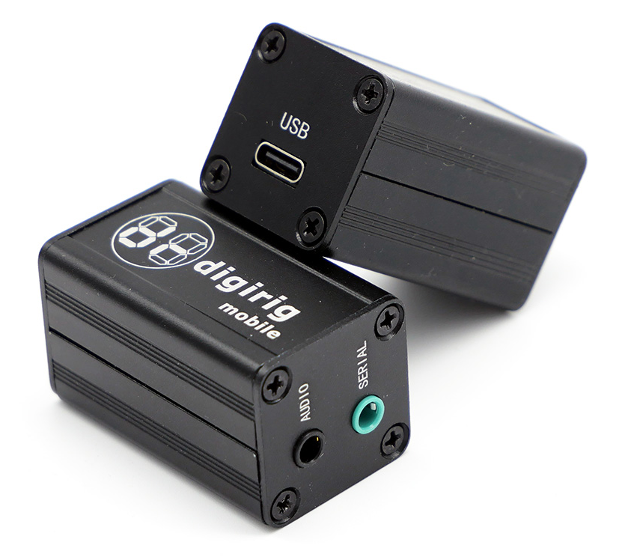
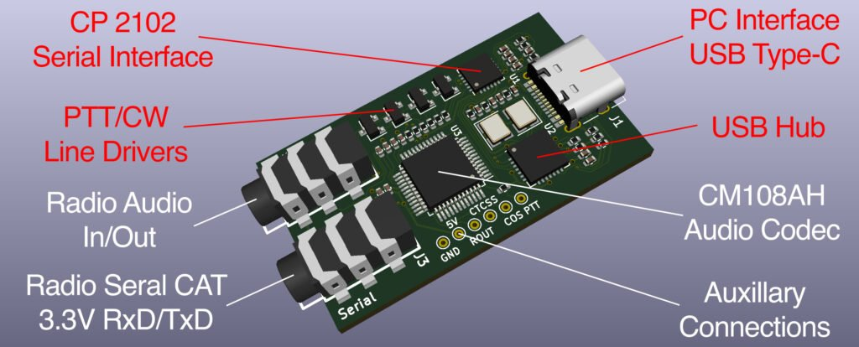
Digirig Hardware
USB SERIAL BRIDGE
TX
USB
RX
RST
USB
HUB
AUDIO
CODEC
USB
Digirig Mobile
https://digirig.net/product/digirig-mobile/

Slide 8
Configuration
Configuration for finding a serial port, and a “sibling” sound card
{
"search_criteria": {
"port": {
"serial": "f6a69ba44567ec119b112342ef680de7"
}
},
"volume_control": {
"controls": [
{
"name": "Speaker",
"playback_value": "100",
"playback_value_test_max_error": "5"
},
{
"name": "Mic",
"playback_value": "40",
"capture_value": "40",
"playback_value_test_max_error": "5",
"capture_value_test_max_error": "5"
}
]
},
"search_mode": "port-siblings"
}

Slide 9
Basic Enumeration Scripting
CLI:
find_devices -c config.json -o out.json --no-stdout
Uses config.json to find sound cards and/or serial ports
Set the volume controls
Write results to
Parsing Output in PowerShell:
$find_devices_output = Get-Content -Path out.json -Raw | ConvertFrom-Json $audio_devices_count = $find_devices_output.audio_devices.Count
$audio_device = $find_devices_output.audio_devices[0].plughw_id
$serial_ports_count = $find_devices_output.serial_ports.Count
$serial_port = $find_devices_output.serial_ports[0].name

Slide 10
Volume Test Scripting
CLI:
find_devices -c config.json -o out.json --no-stdout --no-volume-control
--test-volume-control
Uses config.json to find sound cards and/or serial ports
Tests all volume controls as set in the config.json
Parsing Output in Bash:
volume_control_test_result=$(jq -r .volume_control_test_result out.json)
if [ "$volume_control_test_result" != "success" ]; then
exit 1
fi

Slide 11
Mix and match
{
"volume_control": {
"controls": [
{
"name": "Speaker,
"channels": [
{
"name": "Front Center",
"playback_value": "80"
}
},
{
"name": “Line",
"playback_value": "50",
"capture_value": "50",
"channels": [
{
"name": "Front Left",
"playback_value": “20"
},
{
"name": "Front Right",
"capture_value": “40",
}
}
]
}
}

Slide 12
Other examples

Slide 13
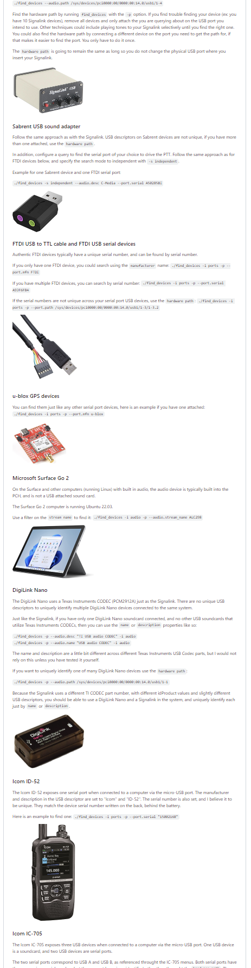
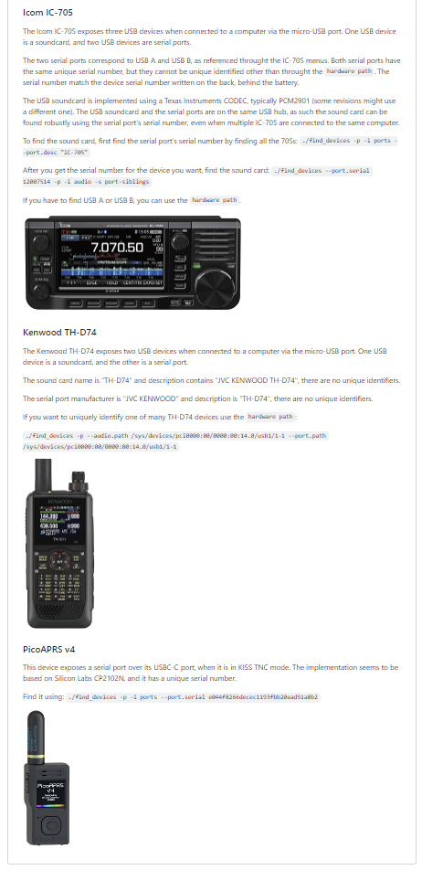
Many Other Examples
https://github.com/iontodirel/find_devices/blob/main/README.md#practical-examples

Slide 14
API Design

Slide 15
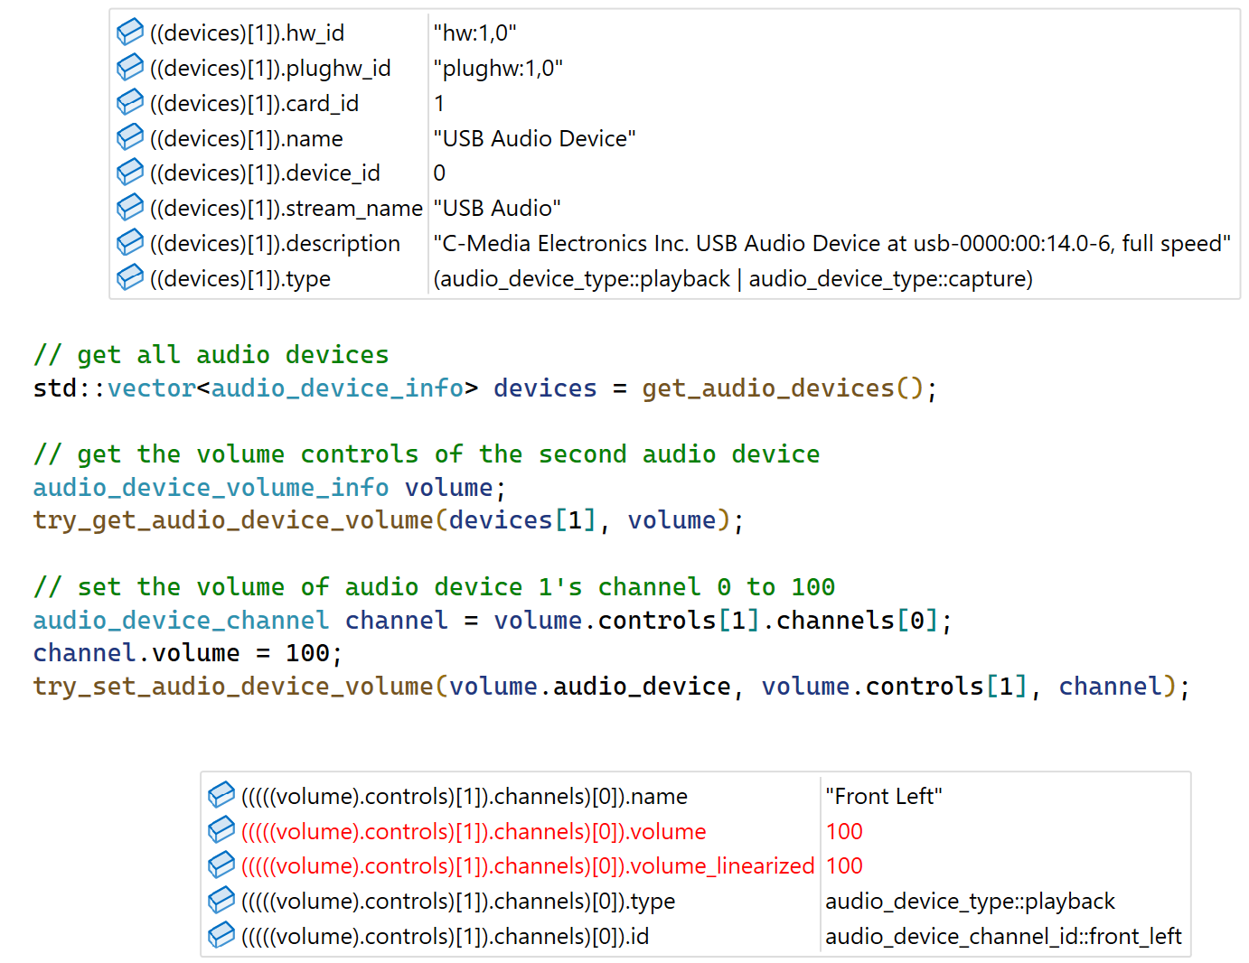
Audio API Design
struct audio_device_info
{
std::string hw_id;
std::string plughw_id;
int card_id = -1;
int device_id = -1;
std::string name;
std::string stream_name;
std::string description;
audio_device_type type = audio_device_type::uknown;
};
struct audio_device_channel
{
std::string name;
int volume = 0;
int volume_linearized = 0;
audio_device_type type = audio_device_type::uknown;
audio_device_channel_id id = audio_device_channel_id::none;
};
struct audio_device_volume_control
{
std::string name;
std::vector<audio_device_channel> channels;
};
struct audio_device_volume_info
{
audio_device_info audio_device;
std::vector<audio_device_volume_control> controls;
};
API Usage Example Runtime Information
std::vector<audio_device_info> get_audio_devices();
bool try_get_audio_device_volume(const audio_device_info& device, audio_device_volume& volume);
bool try_set_audio_device_volume(const audio_device_info& device,
const audio_device_volume_control& control, const audio_device_channel& channel)

Slide 16
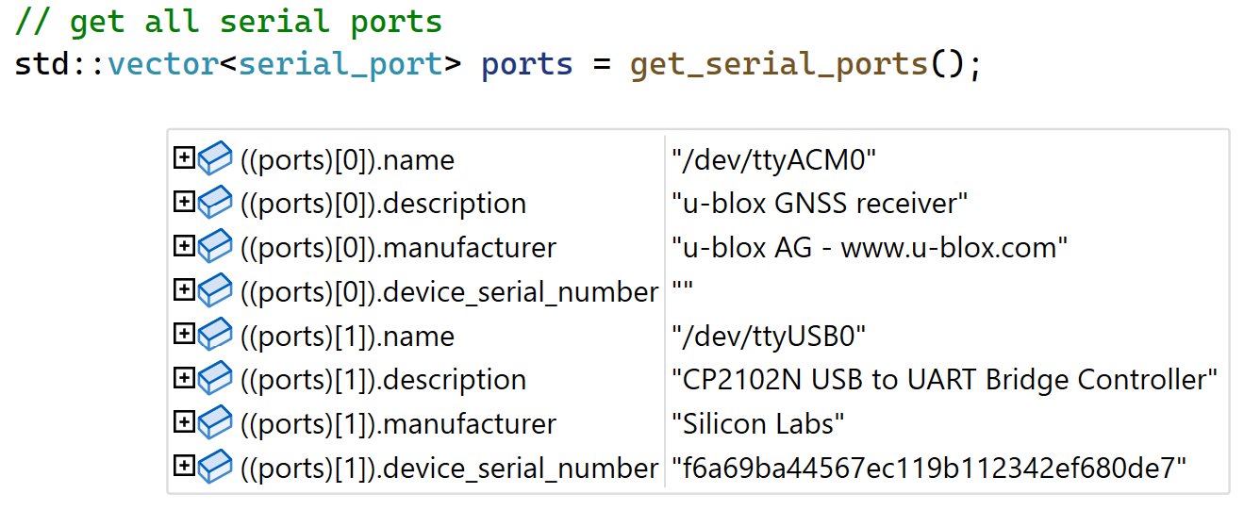
Serial Ports API Design
struct serial_port
{
std::string name;
std::string description;
std::string manufacturer;
std::string device_serial_number;
};
std::vector<serial_port> get_serial_ports();
API Usage Example
Runtime Information

Slide 17
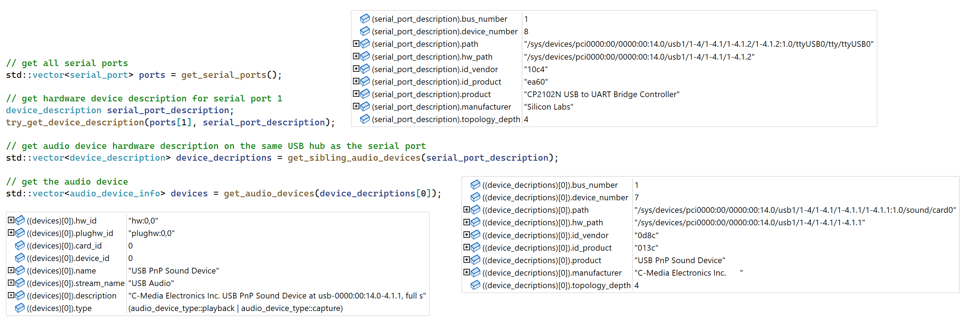
Mapping API Design
struct device_description
{
int bus_number = -1;
int device_number = -1;
std::string path;
std::string hw_path;
std::string id_vendor;
std::string id_product;
std::string product;
std::string manufacturer;
int topology_depth = -1;
};
bool try_get_device_description(const audio_device_info& d, device_description& device);
bool try_get_device_description(const serial_port& d, device_description& device);
std::vector<audio_device_info> get_audio_devices(const device_description& desc);
bool try_get_serial_port(const device_description& desc, serial_port& p);
std::vector<device_description> get_sibling_audio_devices(const device_description& desc);
std::vector<device_description> get_sibling_serial_ports(const device_description& desc);
API Usage Example Runtime Information

Slide 18
Implementation

Slide 19
Library Dependencies
libasaund2-dev – ALSA development library
libudev-dev – Linux udev development library
fmt – Formatting library, now part of C++20
nlohmann/json – JSON library
cxxopts – Command line parsing library

Slide 20
Package Management
apt-get
libasaund2-dev
libudev-dev
CMake (FetchContent)
fmt
nlohmann/json
cxxopts

Slide 21
FetchContent in CMake
if (CMAKE_VERSION VERSION_GREATER_EQUAL "3.24.0")
cmake_policy(SET CMP0135 NEW)
endif()
include(FetchContent)
FetchContent_Declare(json URL https://github.com/nlohmann/json/releases/download/v3.11.2/json.tar.xz)
FetchContent_GetProperties(json)
if(NOT json_POPULATED)
FetchContent_Populate(json)
add_subdirectory(${json_SOURCE_DIR} ${json_BINARY_DIR} EXCLUDE_FROM_ALL)
endif()
target_link_libraries(find_devices PRIVATE nlohmann_json::nlohmann_json)

Slide 22
Enumerating audio devices
#include <alsa/asoundlib.h>
int card_id = -1; while (true)
{
snd_card_next(&card_id);
snd_ctl_t* ctl_handle = nullptr;
snd_ctl_open(&ctl_handle, fmt::format("hw:{}", card_id).c_str(), 0);
while (true)
{
int device_id = -1;
snd_ctl_pcm_next_device(ctl_handle, &device_id);
snd_pcm_info_t* pcm_info = nullptr;
snd_pcm_info_set_device(pcm_info, device_id);
snd_pcm_info_set_subdevice(pcm_info, 0);
snd_pcm_info_set_stream(pcm_info, SND_PCM_STREAM_CAPTURE);
snd_ctl_pcm_info(ctl_handle, pcm_info);
char* name = nullptr;
snd_card_get_name(card_id, &name);
char* long_name = nullptr;
snd_card_get_longname(card_id, &long_name);
fmt::format("hw:{},{}", device.card_id, device.device_id);
}
}
hw:0
USB PnP Sound Device
C-Media Electronics Inc. USB PnP Sound Device
hw:0,1
Notes:
this is what is like using ALSA, it’s a C API
SND_PCM_STREAM_CAPTURE

Slide 23
Volume Controls
#include <alsa/asoundlib.h>
snd_mixer_t* handle;
snd_mixer_selem_id_t* sid;
snd_mixer_open(&handle, 0);
snd_mixer_attach(handle, ("hw:" + std::to_string(device.card_id)).c_str()));
snd_mixer_selem_register(handle, nullptr, nullptr);
snd_mixer_load(handle);
snd_mixer_selem_id_malloc(&sid);
snd_mixer_selem_id_set_index(sid, 0);
snd_mixer_elem_t* elem = nullptr;
for (elem = snd_mixer_first_elem(handle); elem; elem = snd_mixer_elem_next(elem))
{
snd_mixer_selem_get_id(elem, sid);
audio_device_volume_control volume_control;
const char* control_name = snd_mixer_selem_get_name(elem);
for (int channel_id = 0; channel_id <= SND_MIXER_SCHN_REAR_CENTER; channel_id++)
{
const char* channel_name = snd_mixer_selem_channel_name(channel_id);
long min = 0, max = 100, value = 0;
snd_mixer_selem_get_playback_volume_range(elem, &min, &max);
snd_mixer_selem_get_playback_volume(elem, channel_id, &value);
}
}
hw:0
Speaker
Front Left
Notes:
As far as I know this isn’t possible to do in Windows.

Slide 24
Enumerating Serial Ports
#include <libudev.h>
udev* udev = udev_new();
udev_enumerate_add_match_subsystem(enumerate, "tty");
udev_enumerate_scan_devices(enumerate);
udev_list_entry* devices = udev_enumerate_get_list_entry(enumerate);
udev_list_entry* dev_list_entry;
udev_list_entry_foreach(dev_list_entry, devices)
{
const char* path = udev_list_entry_get_name(dev_list_entry);
udev_device* dev = udev_device_new_from_syspath(udev, path);
const char* devnode = udev_device_get_devnode(dev);
udev_device* usb_dev = udev_device_get_parent_with_subsystem_devtype(dev, "usb", "usb_device");
const char* manufacturer = udev_device_get_sysattr_value(usb_dev, "manufacturer");
const char* product = udev_device_get_sysattr_value(usb_dev, "product");
const char* serial = udev_device_get_sysattr_value(usb_dev, "serial"); }
/dev/ttyUSB0
f6a69ba44567ec119b112342ef680de7
Silicon Labs

Slide 25
Mapping: Devices to udev
Serial port to device description
#include <libudev.h>
udev* udev = udev_new();
udev_enumerate* enumerate = udev_enumerate_new(udev);
udev_enumerate_add_match_subsystem(enumerate, "tty");
udev_enumerate_add_match_property(enumerate, "DEVNAME", p.name.c_str());
udev_enumerate_scan_devices(enumerate);
udev_list_entry* devices = udev_enumerate_get_list_entry(enumerate);
udev_device* device = udev_device_new_from_syspath(udev, udev_list_entry_get_name(devices));
udev_device* usb_device = udev_device_get_parent_with_subsystem_devtype(device, "usb", "usb_device");
const char* syspath = udev_device_get_syspath(device);
const char* usb_syspath = udev_device_get_syspath(usb_device);
/dev/ttyUSB0
filter
/sys/devices/pci0000:00/0000:00:14.0/usb1/1-4/1-4.1/1-4.1.2/1-4.1.2:1.0/ttyUSB0/tty/ttyUSB0
Sound card to device description
card0
udev_enumerate_add_match_subsystem(enumerate, "sound");
udev_enumerate_add_match_sysname(enumerate, fmt::format("card{}", d.card_id).c_str());

Slide 26
Mapping: Serial Port to Sound Card
Serial port device description to sound card mapping
/sys/devices/pci0000:00/0000:00:14.0/usb1/1-4/1-4.1/1-4.1.2/1-4.1.2:1.0/ttyUSB0/tty/ttyUSB0
#include <libudev.h>
udev* udev = udev_new();
udev_device* dev = udev_device_new_from_syspath(udev, desc.path.c_str());
udev_device* usb_dev = udev_device_get_parent_with_subsystem_devtype(dev, "usb", "usb_device");
udev_device* parent_usb_dev = udev_device_get_parent_with_subsystem_devtype(usb_dev, "usb", "usb_device");
udev_enumerate* enumerate = udev_enumerate_new(udev);
udev_enumerate_add_match_parent(enumerate, parent_usb_dev);
udev_enumerate_add_match_subsystem(enumerate, "sound");
udev_enumerate_add_match_sysname(enumerate, "card*");
udev_list_entry* sibling_list_entry = nullptr;
udev_list_entry* devices = udev_enumerate_get_list_entry(enumerate);
udev_list_entry_foreach(sibling_list_entry, devices)
{
const char* path = udev_list_entry_get_name(sibling_list_entry);
udev_device* sibling_dev = udev_device_new_from_syspath(udev, path);
udev_device* sibling_usb_device=
udev_device_get_parent_with_subsystem_devtype(device, "usb", "usb_device");
}
/sys/devices/pci0000:00/0000:00:14.0/usb1/1-4/1-4.1/1-4.1.1/1-4.1.1:1.0/sound/card2

Slide 27
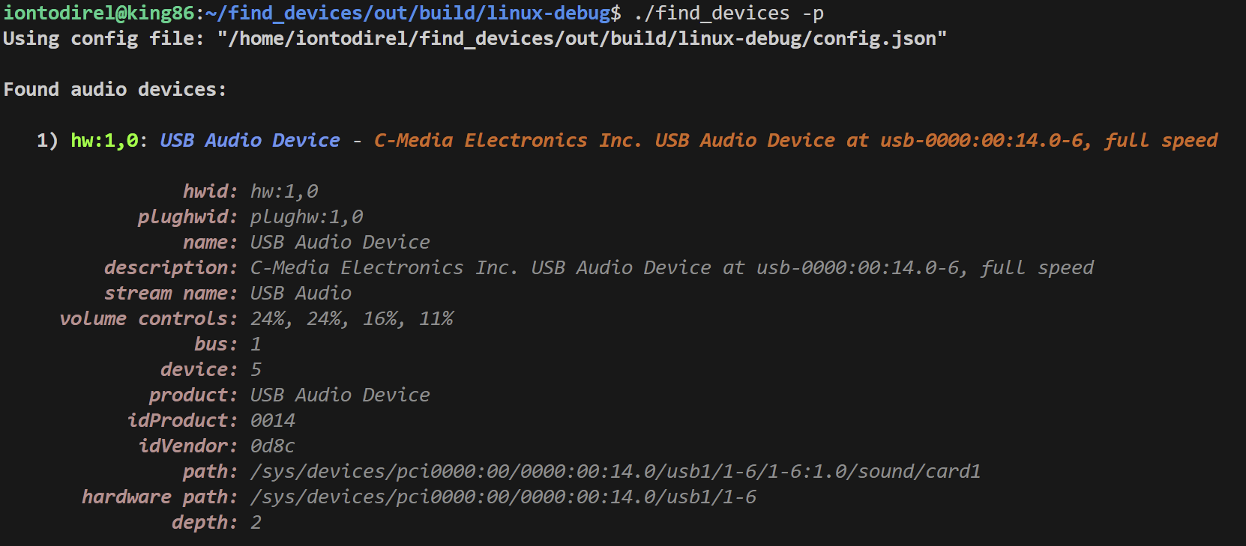
Pretty Printing
fmt library:
fmt::print(fmt::emphasis::bold, "{:>4})", i);
fmt::print(fmt::emphasis::bold | fg(fmt::color::chartreuse), " {}", d.first.audio_device.hw_id);
fmt::print(fmt::emphasis::bold | fmt::emphasis::italic | fg(fmt::color::rosy_brown), "{:>20}: ", "hwid");
fmt::print(fmt::emphasis::italic | fg(fmt::color::gray), "{}\n", d.first.audio_device.hw_id);
Windows Integrated Terminal:

Slide 28
Command Line Parsing
Command line parsing using the cxxopts library
std::map<std::string, option_handler> command_map =
{
{ "version", {"v,version", false, nullptr, [&](const cxxopts::ParseResult& result) { args.show_version = true; }}},
{ "disable-colors", {"disable-colors", false, nullptr, [&](const cxxopts::ParseResult& result) { args.disable_colors = result["disable-colors"].as<bool>(); }}},
{ "disable-file-write", {"disable-file-write", false, nullptr, [&](const cxxopts::ParseResult& result) { args.disable_write_file = result["disable-file-write"].as<bool>(); }}},
{ "port.bus", {"port.bus", true, cxxopts::value<int>(), [&](const cxxopts::ParseResult& result) {
try_parse_number(result["port.bus"].as<std::string>(), args.port_filter.bus);
}}},
}; cxxopts::Options options("", "");
cxxopts::OptionAdder option_group = options.allow_unrecognised_options().add_options();
for (const auto& command : command_map)
{
option_group(command.second.command_line_arg_name, "", command.second.type);
}
cxxopts::ParseResult result;
try
{
result = options.parse(argc, argv);
}
catch (const cxxopts::exceptions::incorrect_argument_type& e) {/*Error parsing command line*/ }
catch (const std::exception& e) {} for (const auto& command : command_map)
{
const std::string& key = command.first;
const std::function<void(const cxxopts::ParseResult&)>& handler = command.second.read_handler;
if (result.count(key) > 0)
{
handler(result);
}
}
struct option_handler
{
std::string command_line_arg_name;
bool has_type = false;
std::shared_ptr<cxxopts::Value> type;
std::function<void(const cxxopts::ParseResult&)> read_handler;
};
option_handler

Slide 29
Testing

Slide 30
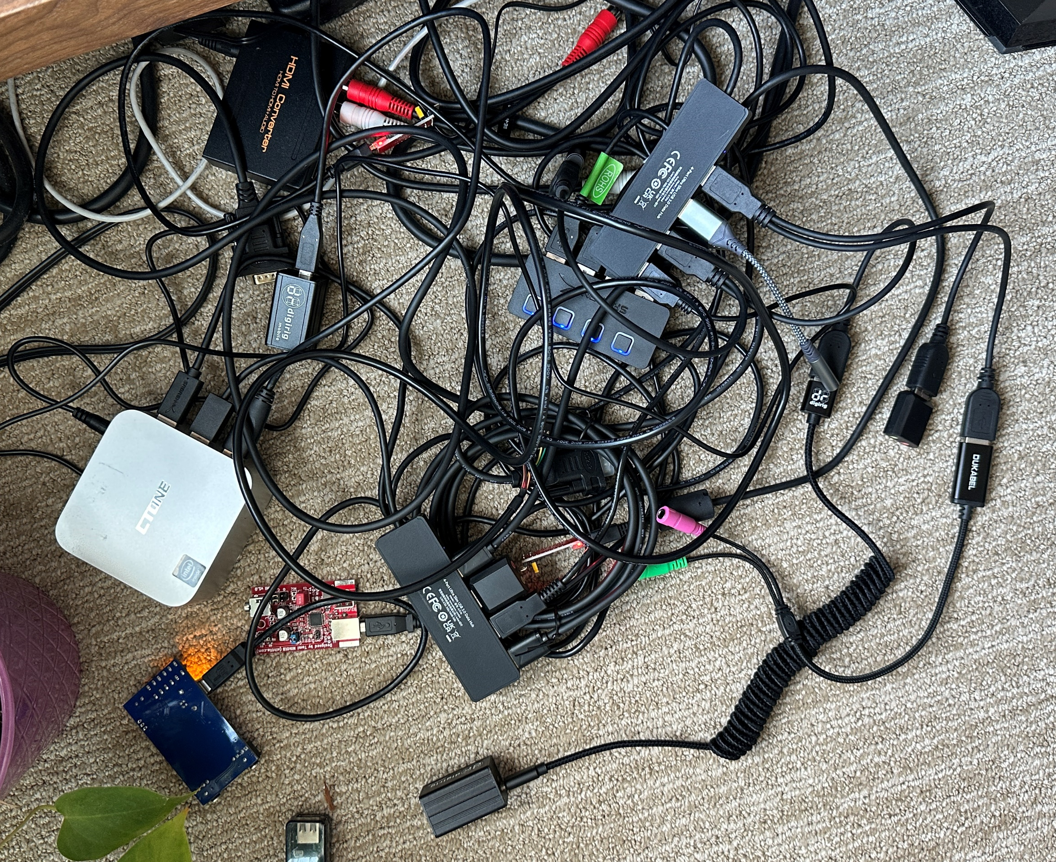
Hardware
8
4
9
3
2
7
6
5
1

Slide 31
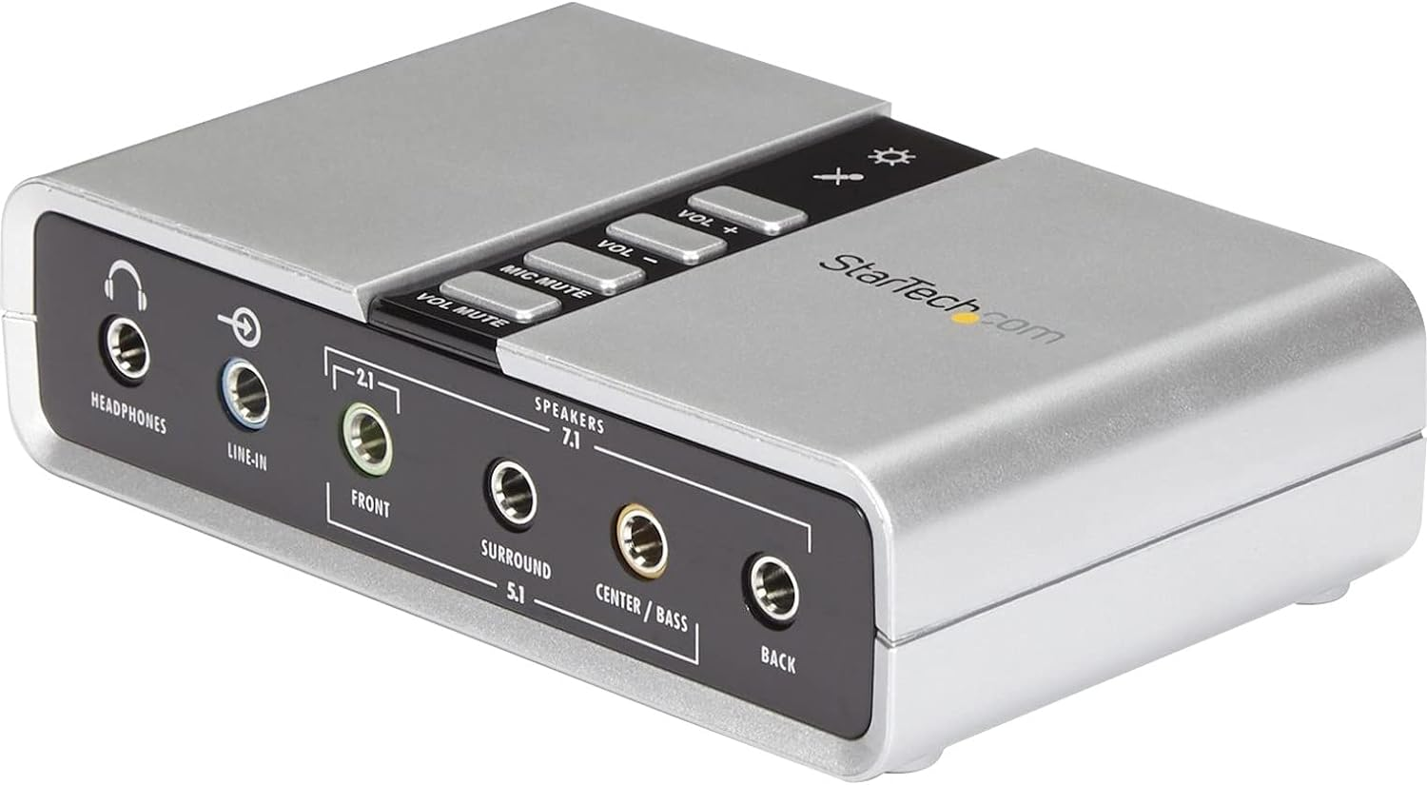
Hardware
{
"name": "Line",
"channels": [
{
"name": "Front Left",
"type": "playback",
"volume": "76",
"channel": "front_left"
},
{
"name": "Front Left",
"type": "capture",
"volume": "0",
"channel": "front_left"
},
{
"name": "Front Right",
"type": "playback",
"volume": "76",
"channel": "front_right"
},
{
"name": "Front Right",
"type": "capture",
"volume": "0",
"channel": "front_right"
}
]
},
{
"name": "Mic",
"channels": [
{
"name": "Front Left",
"type": "playback",
"volume": "76",
"channel": "front_left"
},
{
"name": "Front Left",
"type": "capture",
"volume": "100",
"channel": "front_left"
},
{
"name": "Front Right",
"type": "playback",
"volume": "76",
"channel": "front_right"
},
{
"name": "Front Right",
"type": "capture",
"volume": "100",
"channel": "front_right"
}
]
}
],
"bus_number": "1",
"device_number": "9",
"id_product": "0102",
"id_vendor": "0d8c",
"device_manufacturer": "",
"path": "/sys/devices/pci0000:00/0000:00:14.0/usb1/1-3/1-3:1.0/sound/card3",
"hw_path": "/sys/devices/pci0000:00/0000:00:14.0/usb1/1-3",
"product": "USB Sound Device ",
"topology_depth": "2"
}
]
}
{
"audio_devices": [
{
"card_id": "3",
"device_id": "0",
"plughw_id": "plughw:3,0",
"hw_id": "hw:3,0",
"name": "ICUSBAUDIO7D",
"description": "ICUSBAUDIO7D at usb-0000:00:14.0-3, full speed",
"type": "capture&playback",
"controls": [
{
"name": "Speaker",
"channels": [
{
"name": "Front Left",
"type": "playback",
"volume": "36",
"channel": "front_left"
},
{
"name": "Front Right",
"type": "playback",
"volume": "36",
"channel": "front_right"
},
{
"name": "Rear Left",
"type": "playback",
"volume": "36",
"channel": "rear_left"
},
{
"name": "Rear Right",
"type": "playback",
"volume": "36",
"channel": "rear_right"
},
{
"name": "Front Center",
"type": "playback",
"volume": "36",
"channel": "front_center"
},
{
"name": "Woofer",
"type": "playback",
"volume": "36",
"channel": "woofer"
},
{
"name": "Side Left",
"type": "playback",
"volume": "36",
"channel": "side_left"
},
{
"name": "Side Right",
"type": "playback",
"volume": "36",
"channel": "side_right"
}
]
},
A 7.1 channel sound card

Slide 32
Usage in Docker & Running an APRS digipeater

Slide 33
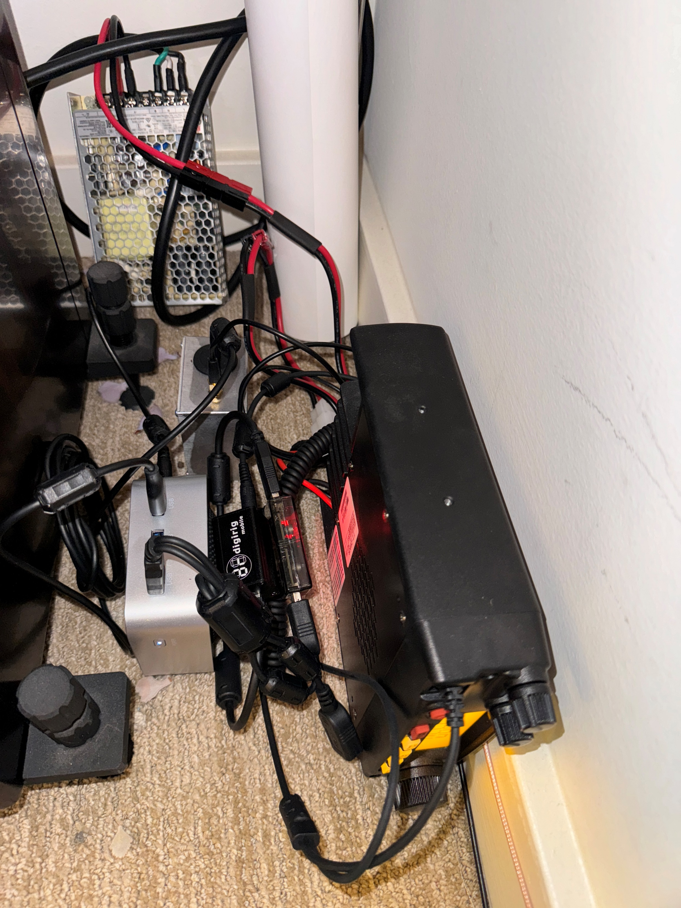
APRS Digipeater Station
No overlays

Slide 34
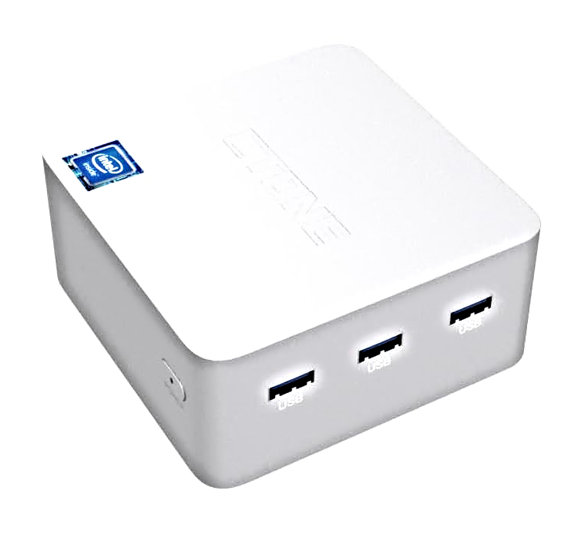
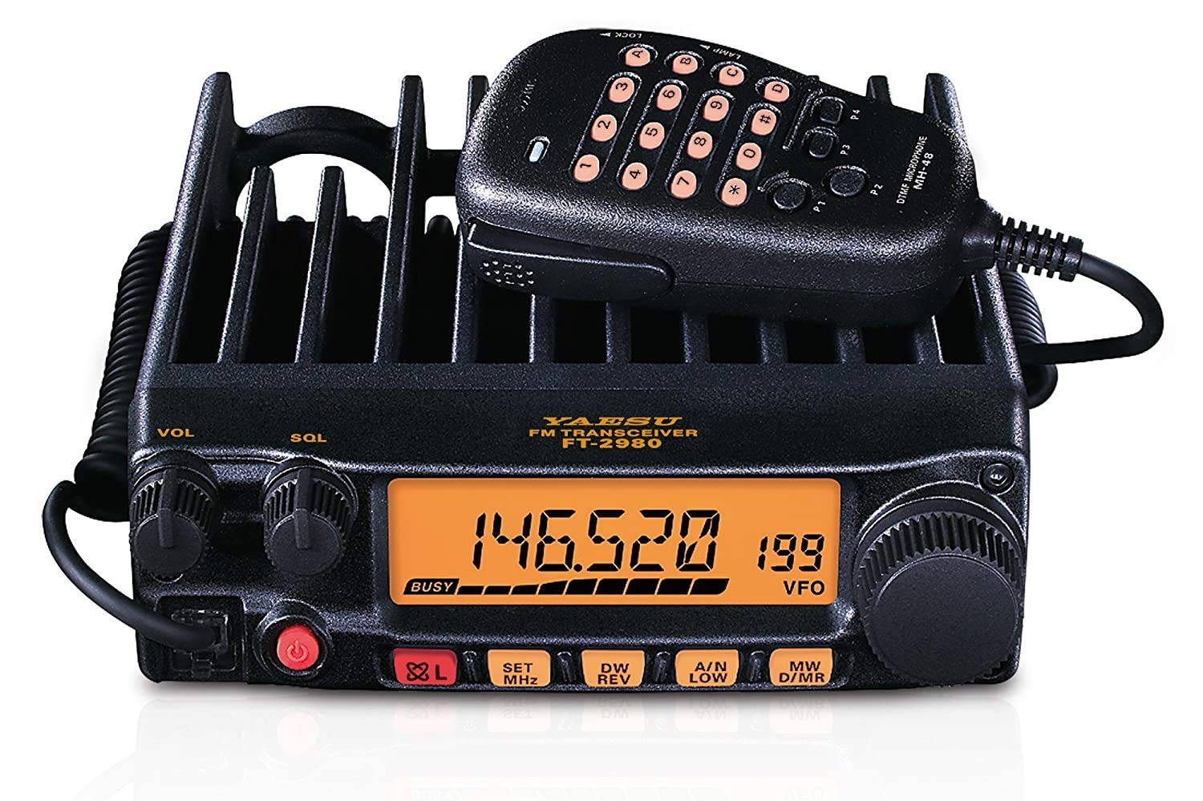
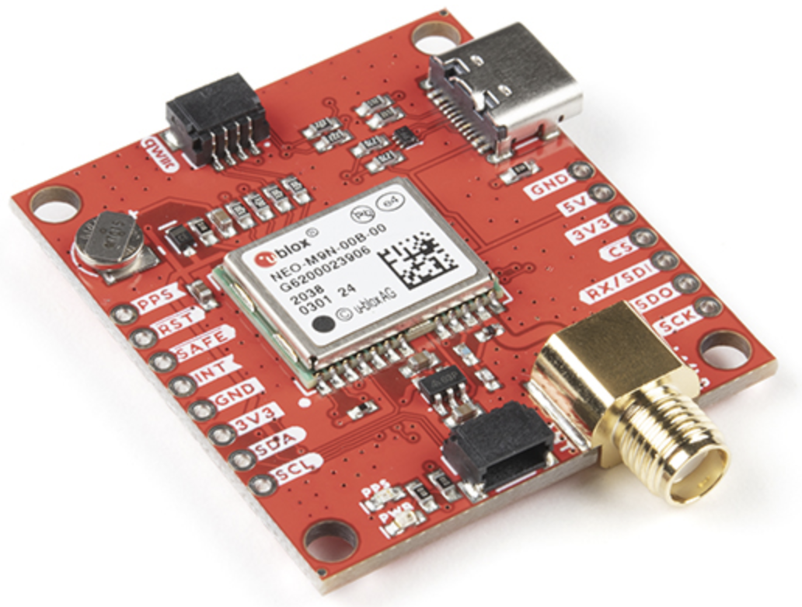
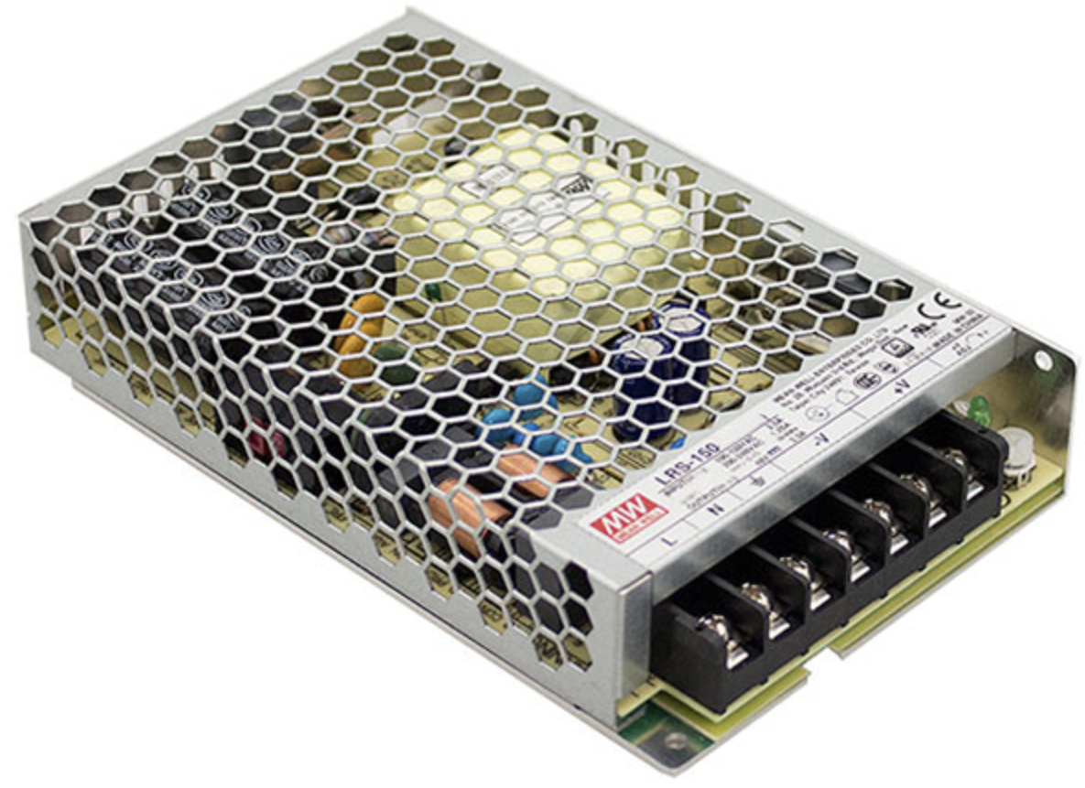
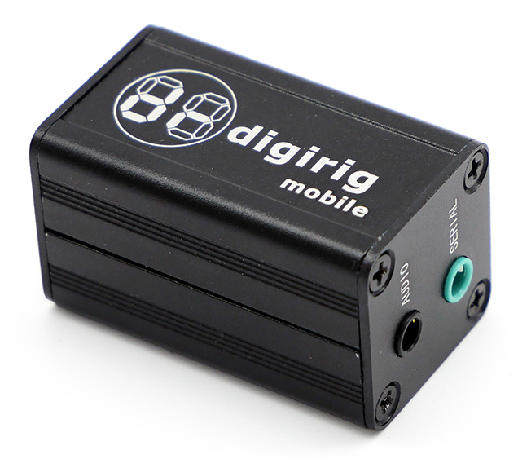
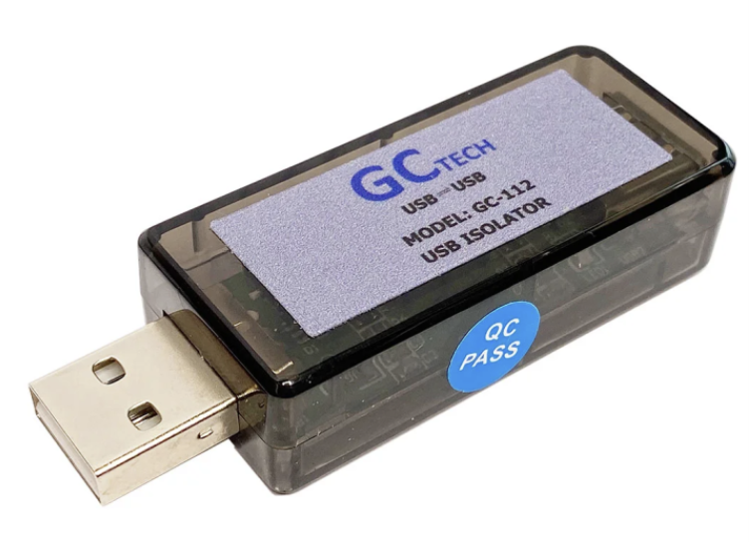
APRS Digipeater Station
12V power supply
Radio: Yaesu FT-2980R
Soundcard: Digirig
GPS receiver: u-blox NEO-M9N
Mini-Computer: Intel N95 based
Power supply: MEAN WELL LRS-150-12
GPS receiver
mini-computer
hardware
soundcard
with PTT circuit
USB isolator
radio transceiver

Slide 35
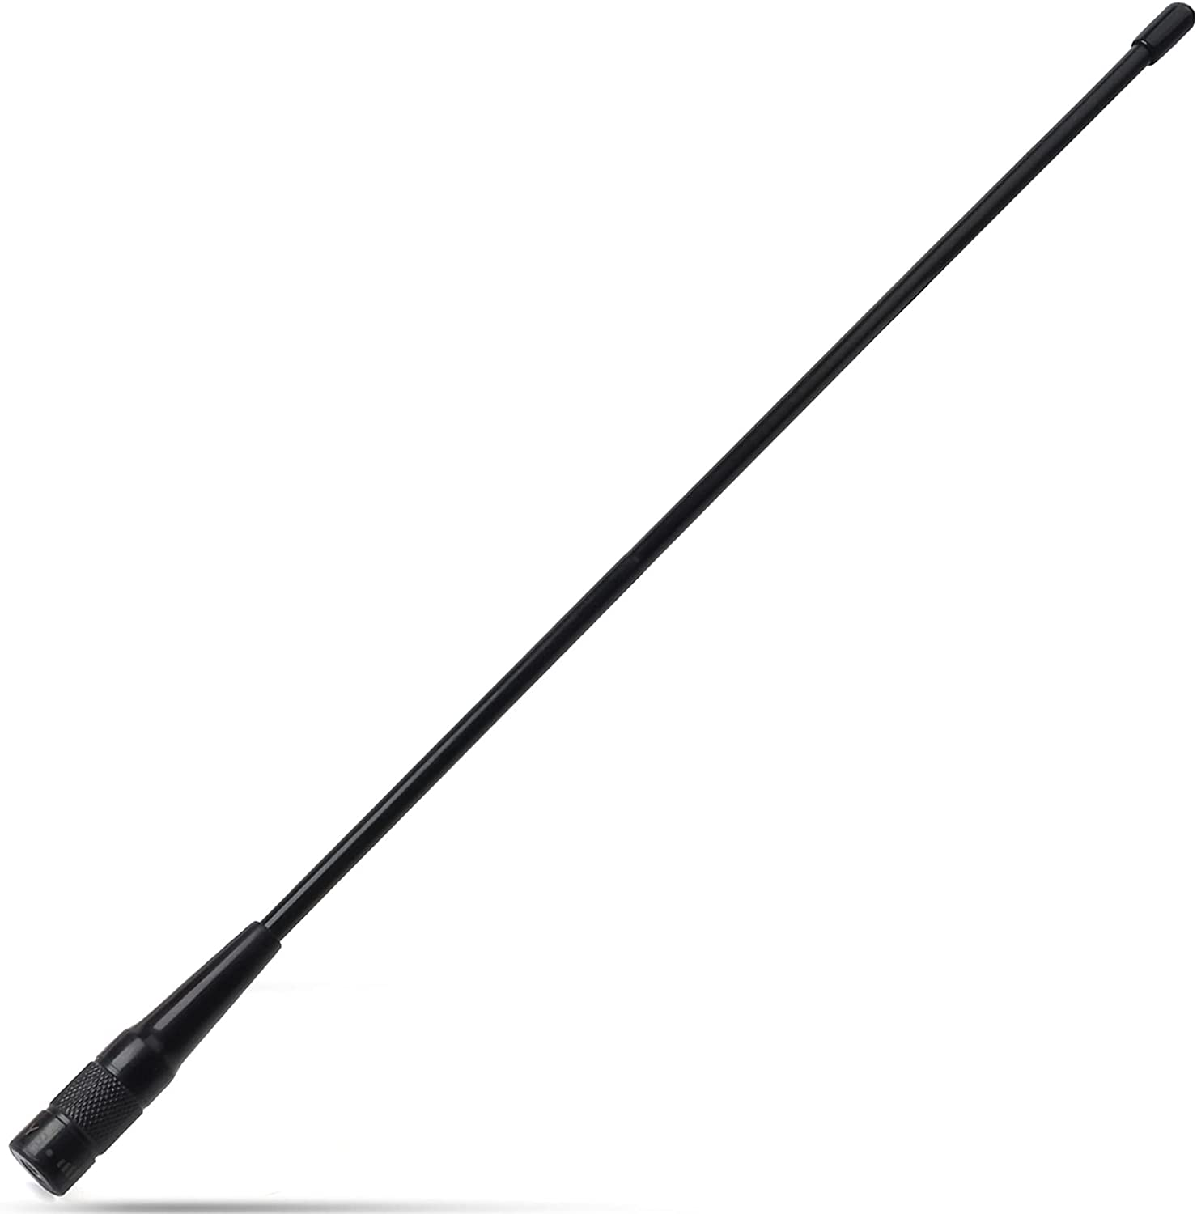
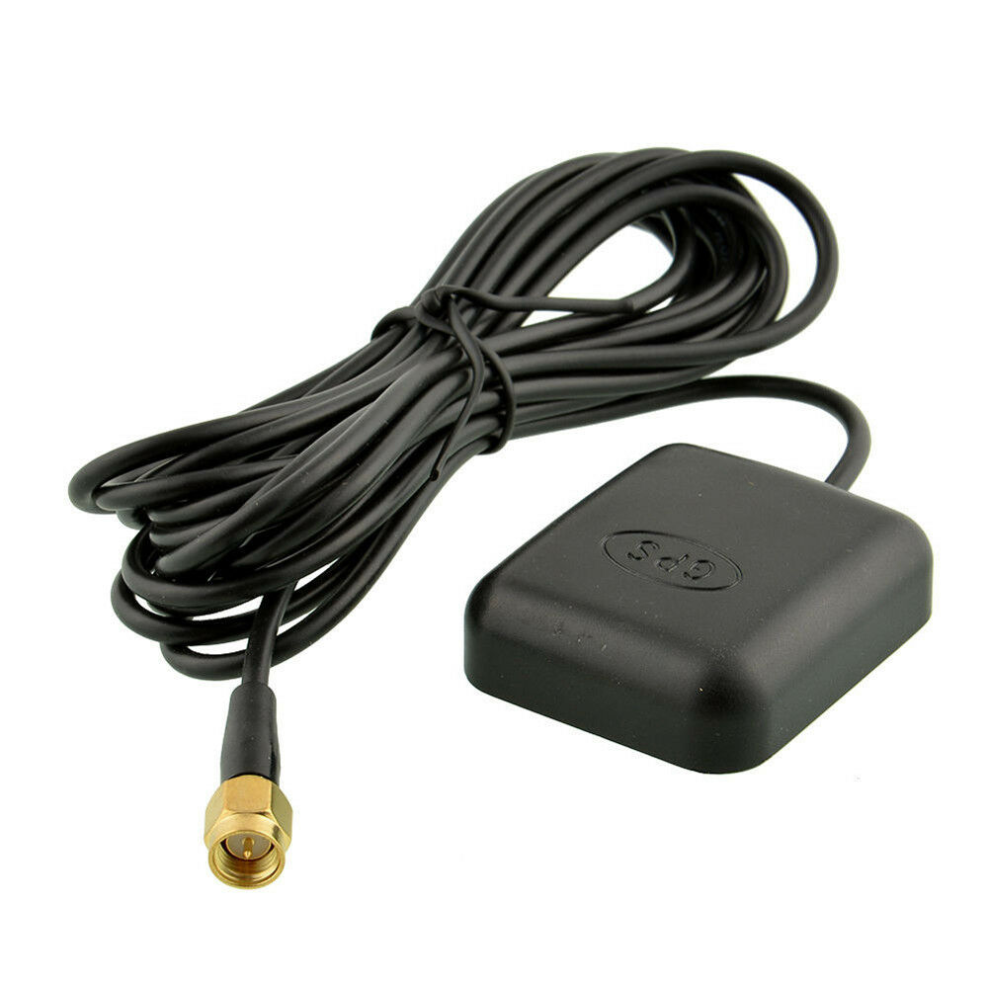
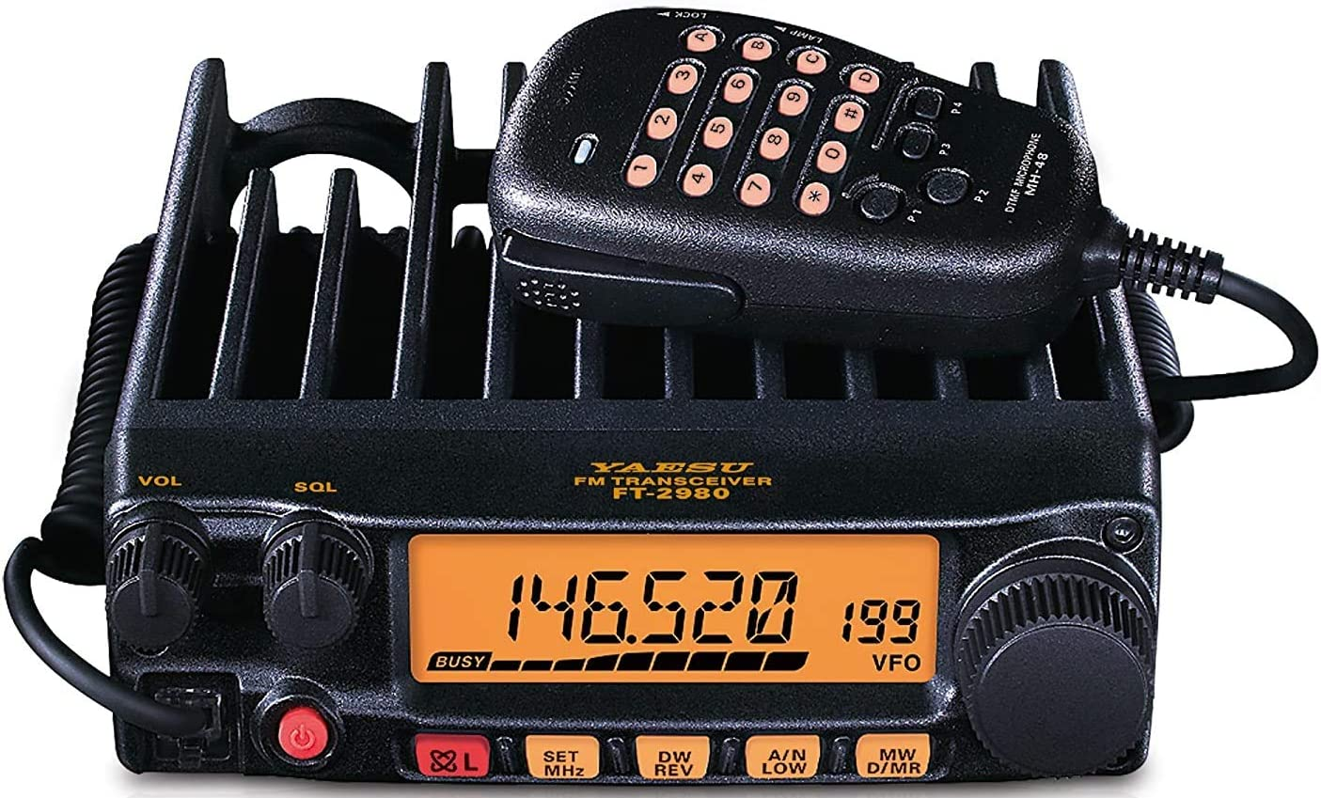
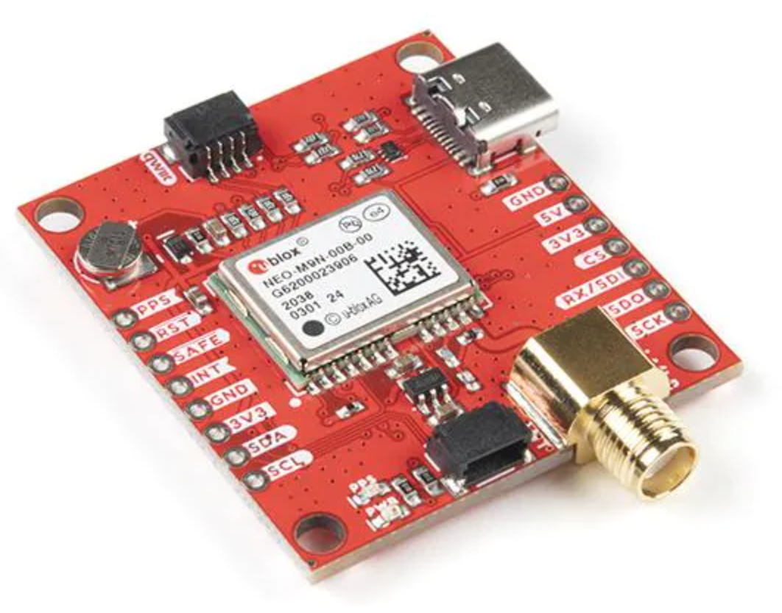
Hardware Architecture
VHF antenna
12V
system voltage
SMA
Digirig
USB Sound Card
5V system voltage
SO-239
USB-C (power only)
TX
line out
USB
Audio class
Wi-Fi antenna
radio
transceiver
sound
card
USB
USB
Linux
Environment
Mic
RX
line in
Speaker
USB
Serial Port
UART
bridge
USB
USB
PTT
switch
GPS antenna
GPS
USB
Serial Port
SMA
USB
USB

Slide 36
Docker Compose
direwolfm:
env_file:
- ".env"
build:
context: .
dockerfile: ./direwolf/Dockerfile
image: "direwolf"
ports:
- "${MODEM0_AGWP_PORT}:${MODEM0_PRIV_AGWP_PORT}“ # exposing KISS and AGWP ports to the host
- "${MODEM0_KISS_PORT}:${MODEM0_PRIV_KISS_PORT}"
volumes:
# find_devices config can be changed without rebuilding
- ${MODEM0_FD_CONFIG_FILE_NAME}:${MODEM0_PRIV_FD_CONFIG_FILE_NAME}
- ${MODEM0_LOG_DIR}:${MODEM0_PRIV_LOG_DIR} # share volume with host, for logging, so Direwolf logs can be read on the host
- ${MODEM0_DW_CONFIG_FILE_NAME}:${MODEM0_PRIV_DW_CONFIG_FILE_NAME} # Direwolf config, can be changed without rebuilding
- ./settings.json:${MODEM0_PRIV_SETTINGS_FILE_NAME}
networks:
- direwolf_network
- db_network
privileged: true
labels:
- "autoheal=true"
depends_on:
- db
healthcheck:
test: ["CMD", "pwsh", "-ExecutionPolicy", "Bypass", "-File", "/healthcheck.ps1"]
interval: "10s" # the interval to to perform health check
start_period: "60s" # how long it takes to start the container
retries: 1 # how many times to retry until the container becomes unhealty
timeout: "30s" # how long until the health check completes
restart: always

Slide 37
Docker Compose continued
autoheal:
env_file:
- .env
image: willfarrell/autoheal:latest
logging:
driver: "json-file"
options:
max-size: "10m"
max-file: "10"
tty: true
environment:
- AUTOHEAL_CONTAINER_LABEL=all
volumes:
- /var/run/docker.sock:/var/run/docker.sock
restart: always

Slide 38
Dockerfile
FROM ubuntu:23.10
RUN apt-get update -y
RUN apt-get install -y alsa-tools alsa-utils gcc g++ make cmake libasound2-dev libudev-dev git jq mysql-client netcat-traditional wget sox bc
RUN git clone https://github.com/iontodirel/find_devices.git
WORKDIR /find_devices
RUN cmake .
RUN make -j 4
RUN mkdir /powershell
WORKDIR /powershell
RUN wget https://github.com/PowerShell/PowerShell/releases/download/v7.2.12/powershell-lts_7.2.12-1.deb_amd64.deb
RUN dpkg -i powershell-lts_7.2.12-1.deb_amd64.deb
RUN apt-get install -f
WORKDIR /
RUN git clone https://github.com/iontodirel/direwolf-experimental.git
WORKDIR /direwolf-experimental
RUN cmake .
RUN make -j 4
RUN make install
WORKDIR /
COPY ./direwolf/entrypoint.ps1 entrypoint.ps1
COPY ./common.ps1 common.ps1
COPY ./direwolf/healthcheck.ps1 healthcheck.ps1
RUN chmod +x entrypoint.ps1 healthcheck.ps1
CMD ["pwsh", "/entrypoint.ps1"]

Slide 39
entrypoint.ps1
. ./common.ps1
$serial_port = Get-SerialPort-ExitOnError -find_devices_config_file $find_devices_internal_config_file_name
-find_devices_utility $find_devices_file_name
-find_devices_output_json_file $find_devices_internal_output_json_file_name
$audio_device = Get-AudioDevice-ExitOnError -find_devices_config_file $find_devices_internal_config_file_name
-find_devices_utility $find_devices_file_name
-find_devices_output_json_file $find_devices_internal_output_json_file_name
Set-AudioDeviceVolume-ExitOnError -find_devices_config_file $find_devices_internal_config_file_name
-find_devices_utility $find_devices_file_name
Test-SerialPort-ExitOnError -serial_port $serial_port
Test-AudioDevice-ExitOnError -audio_device $audio_device -soundcard_test_wav_file_name $soundcard_test_wav_file_name
Update-DirewolfConfigFile -file_path $direwolf_internal_config_working_file_name `
-audio_device $audio_device `
-ptt_serial_port $serial_port `
-callsign $callsign `
-modem_internal_agwp_port $modem_internal_agwp_port_number `
-modem_internal_kiss_port $modem_internal_kiss_port_number
& /usr/local/bin/direwolf -t 0 -a 10 -c $direwolf_internal_config_working_file_name -l $modem_internal_log_directory 2>&1 |
tee -a $modem_internal_log_directory/direwolf-stdout.log

Slide 40
healthcheck.ps1
If any of the tests fail, the container becomes unhealthy and autoheal will restart it
. ./common.ps1
$null = Get-SerialPort-ExitOnError -find_devices_config_file $find_devices_internal_config_file_name
-find_devices_utility $find_devices_file_name
-find_devices_output_json_file $find_devices_internal_output_json_file_name
$null = Get-AudioDevice-ExitOnError -find_devices_config_file $find_devices_internal_config_file_name
-find_devices_utility $find_devices_file_name
-find_devices_output_json_file $find_devices_internal_output_json_file_name
Test-AudioDeviceVolume2-ExitOnError -find_devices_config_file $find_devices_internal_config_file_name
-find_devices_utility $find_devices_file_name
Test-TcpConnection-ExitOnError -host_name $service_name -port_number $modem_internal_kiss_port_number
Containers health check

Slide 41
Direwolf configuration
# DO NOT CHANGE, it will automatically be replaced in the container by entrypoint.ps1
@ADEVICE plughw:0,0
# DO NOT CHANGE, it will automatically be replaced in the container by entrypoint.ps1
# replace PTT with your own serial port if needed,
# some devices like Signalink have VOX and don't need
# the PTT line, comment it if the case, but also update entrypoint.ps1
@PTT /dev/ttyXYZ RTS
ACHANNELS 1
CHANNEL 0
DTMF
MODEM 1200
# DO NOT CHANGE, it will automatically be replaced in the container by entrypoint.ps1
@MYCALL N0CALL
@AGWPORT 8000
@KISSPORT 8001
NOTE: Everything starting with @ is automatically substituted in entrypoint.ps1

Slide 42
APRX configuration
@mycall N0CALL
@myloc lat 0000.00N lon 00000.00W
<aprsis>
@passcode 0000
@server rotate.aprs2.net
heartbeat-timeout 1m
</aprsis>
<interface>
@tcp-device 127.0.0.1 8001 KISS
callsign $mycall
tx-ok true
telem-to-is true
</interface>
<beacon>
beaconmode both
cycle-size 45m
beacon interface $mycall via WIDE1-1 symbol "I&" $myloc comment "Downtown Bellevue fill-in TX iGate (722d3)"
</beacon>
<digipeater>
transmitter $mycall
<source>
source $mycall
relay-type directonly
viscous-delay 5
</source>
</digipeater>
digipeater
NOTE: Everything starting with @ is automatically substituted in entrypoint.ps1

Slide 43
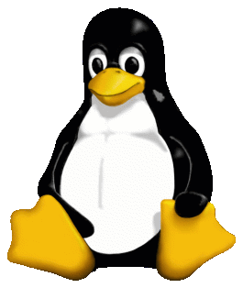

Software Architecture
Linux
Intel N95
PinPoint
Direwolf Container
Digirig
KISS TNC
1
radio
USB sound card
device
Direwolf
Xastir
USB
ALSA
TCP
4
configuration
find_devices
direwolf.conf
IO
Aprx Container
Alsa
Digipeater
u-blox NEO-M9N
GPS
device
USB
serial
gpsd
Aprx
USB
TCP
TCP
USB
TCP
3
IO
IO
2
find_devices
5
aprx.conf
exec
TCP
gps_util
configuration
hardware
GPS Container
clients

Slide 44
USB Soundcard HW Design

Slide 45
USB Sound Card Types
Integrated USB to analog CODECs ex: TI PCM2903C
MCU/DSP to I2S and I2S CODEC ex: ST STM32F769
MCU PWM based implementation ex: NXP MIMXRT1062
USB to I2S bridge and I2S CODEC ex: Silicon Labs CP2615
USB Transceiver + FPGA + ADC/DAC ex: SMSC USB3317C

Slide 46
USB Audio Codecs and I2S bridges
Texas Instruments PCM2900C
Texas Instruments PCM2902C
Texas Instruments PCM2903C
Texas Instruments PCM2912A
C-Media CM108
Silicon Labs CP2615
Microchip USB24913P
ST Micro STM32F411
Cirrus Logic CS4244
Cirrus Logic CS4245
Analog Devices AD74111
Maxim MAX9860
AKM AK4558
AKM AK4571
FTDI FT901

Slide 47
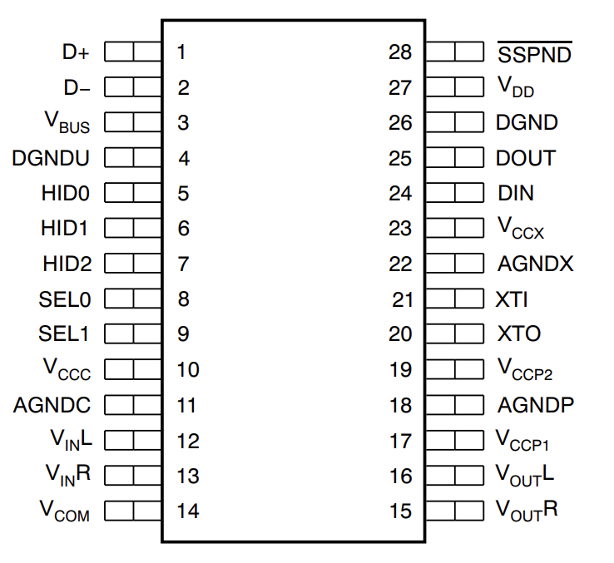
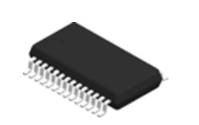
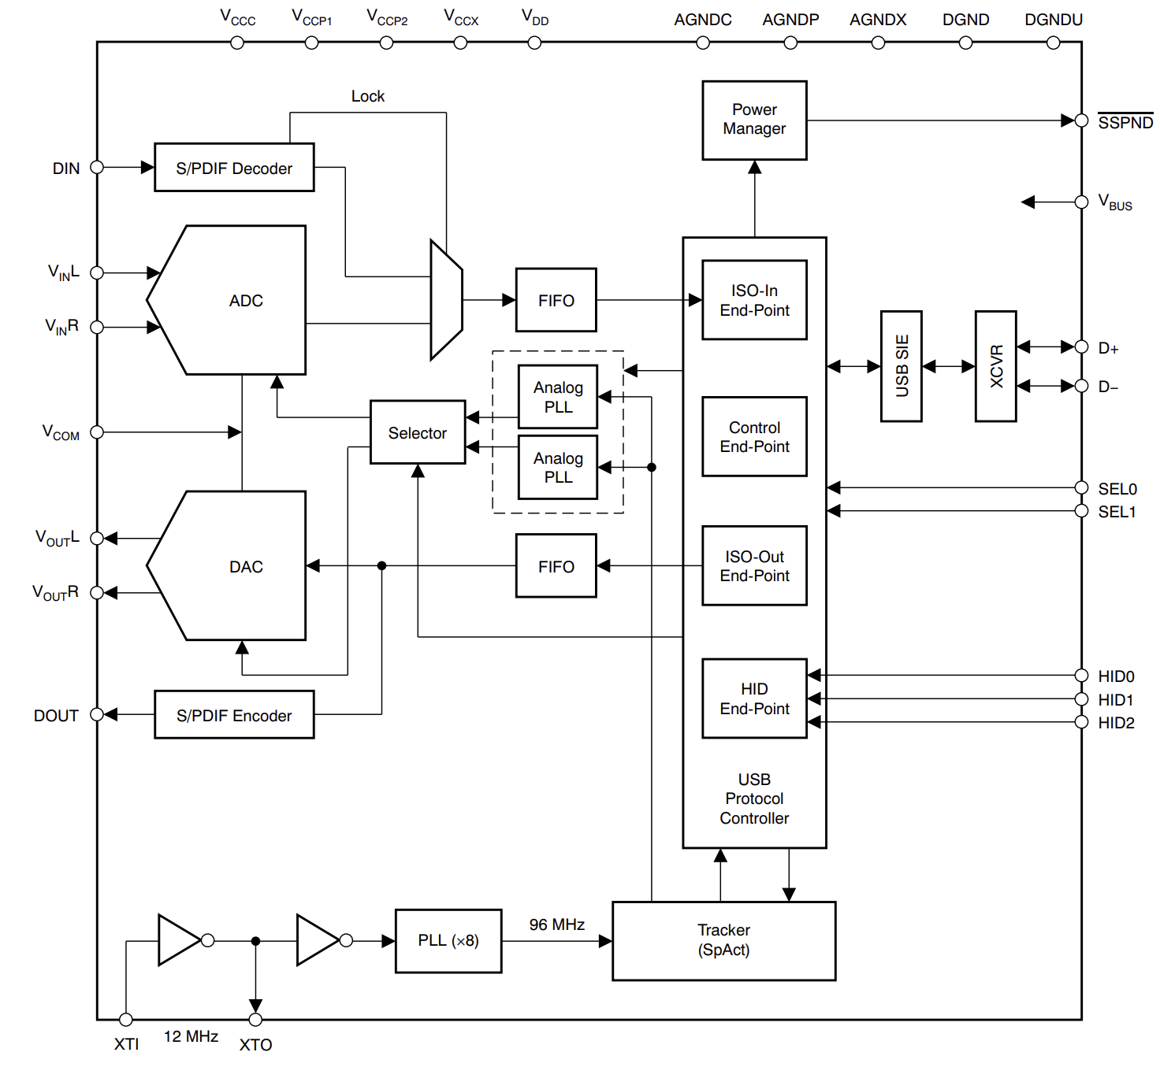
Texas Instruments PCM2903C
USB 2.0
Self-Powered
16-Bit Delta-Sigma ADC and DAC
DAC: 32, 44.1, 48 kHz
ADC: 8, 11.025, 16, 22.05, 32, 44.1, 48 kHz
THD+N = 0.01%
SNR = 89 dB
Dynamic Range = 89 dB
Single 3.3V Power Supply
Single-Ended Voltage Input
$8.57
Package
System diagram

Slide 48
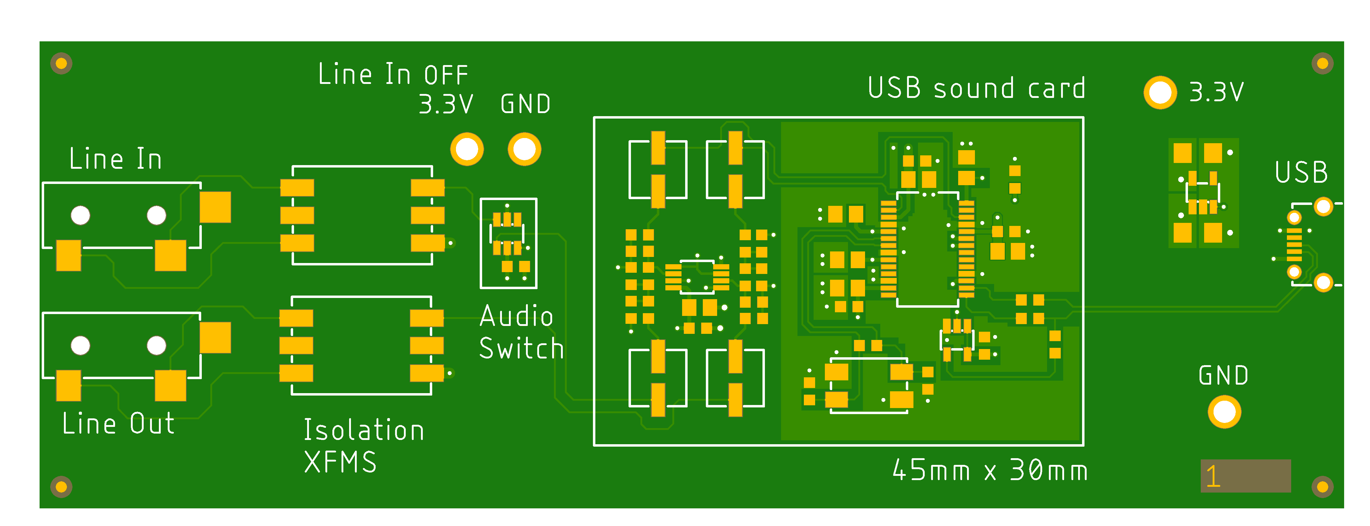
A TI PCM2903C based design
Soundcard PCB render

Slide 49
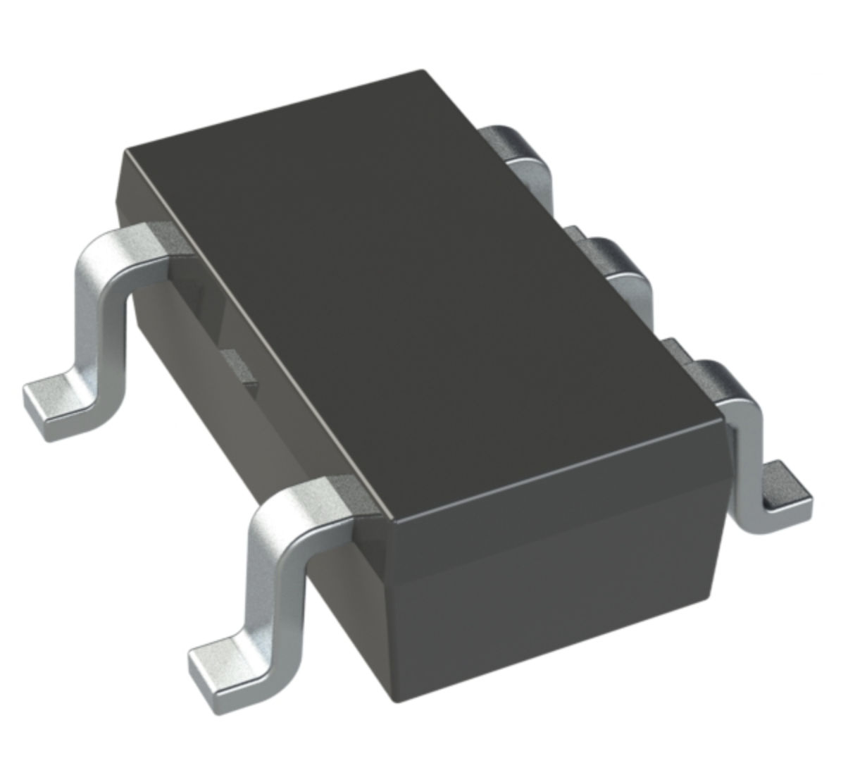
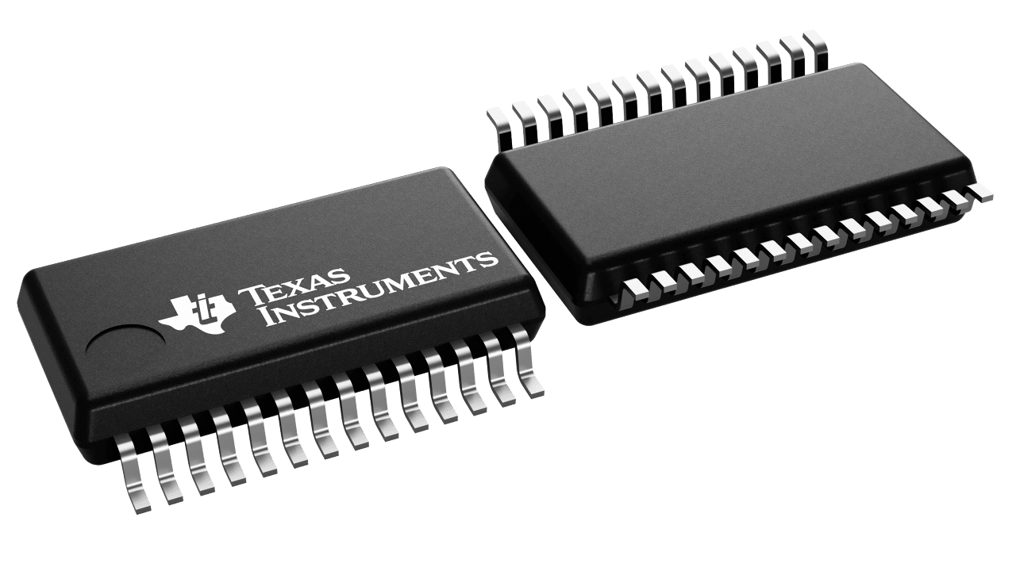
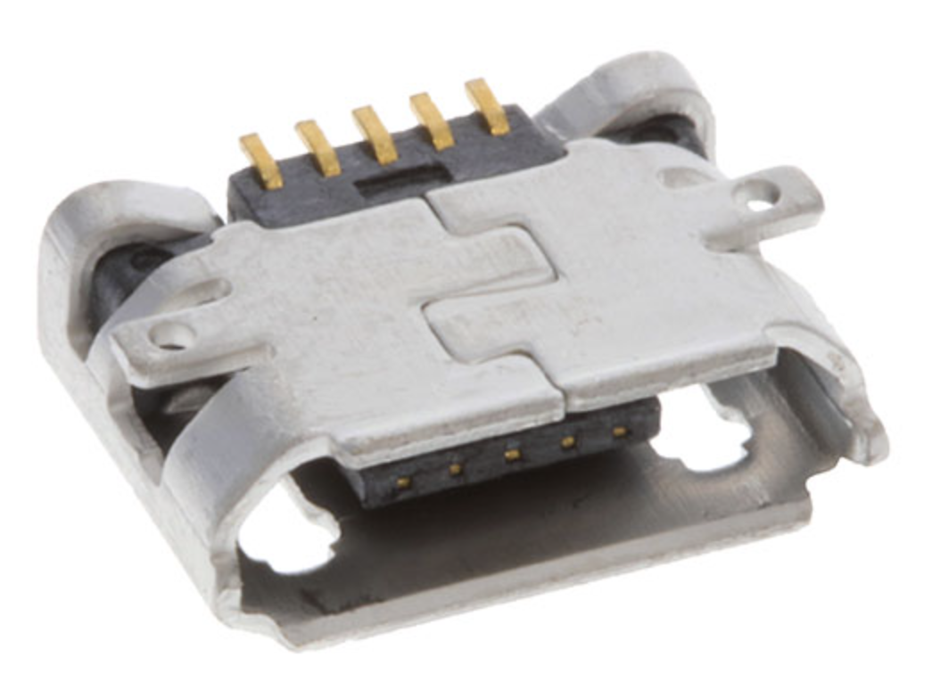
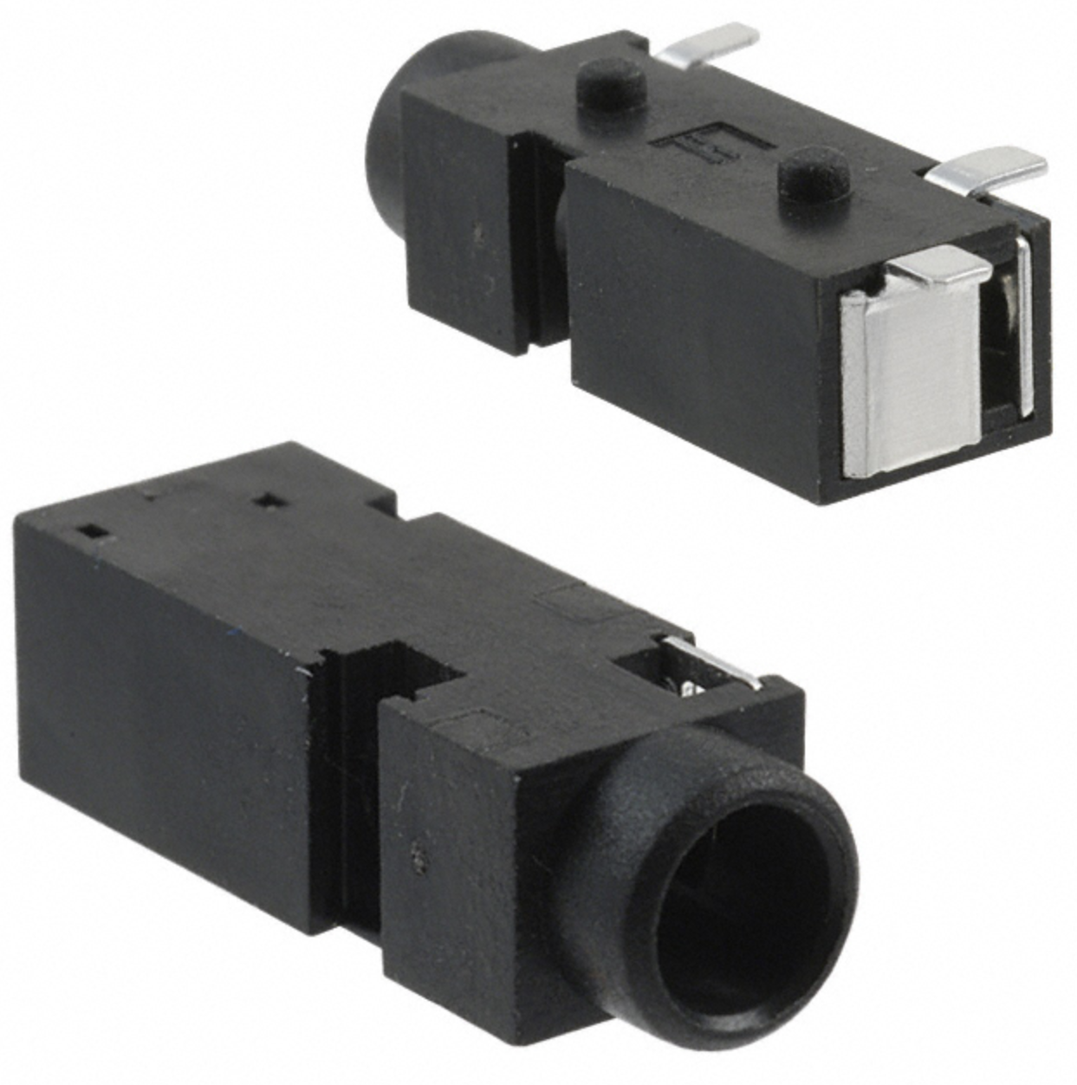
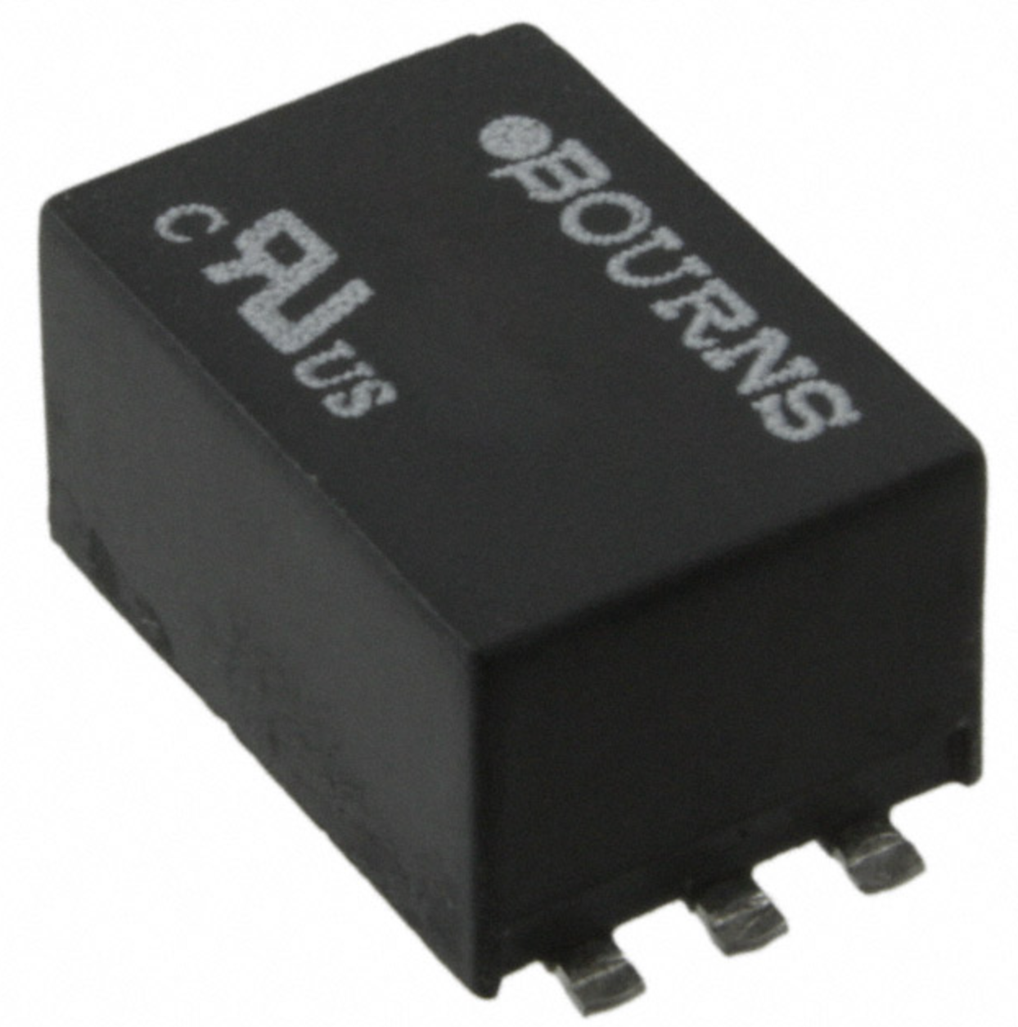
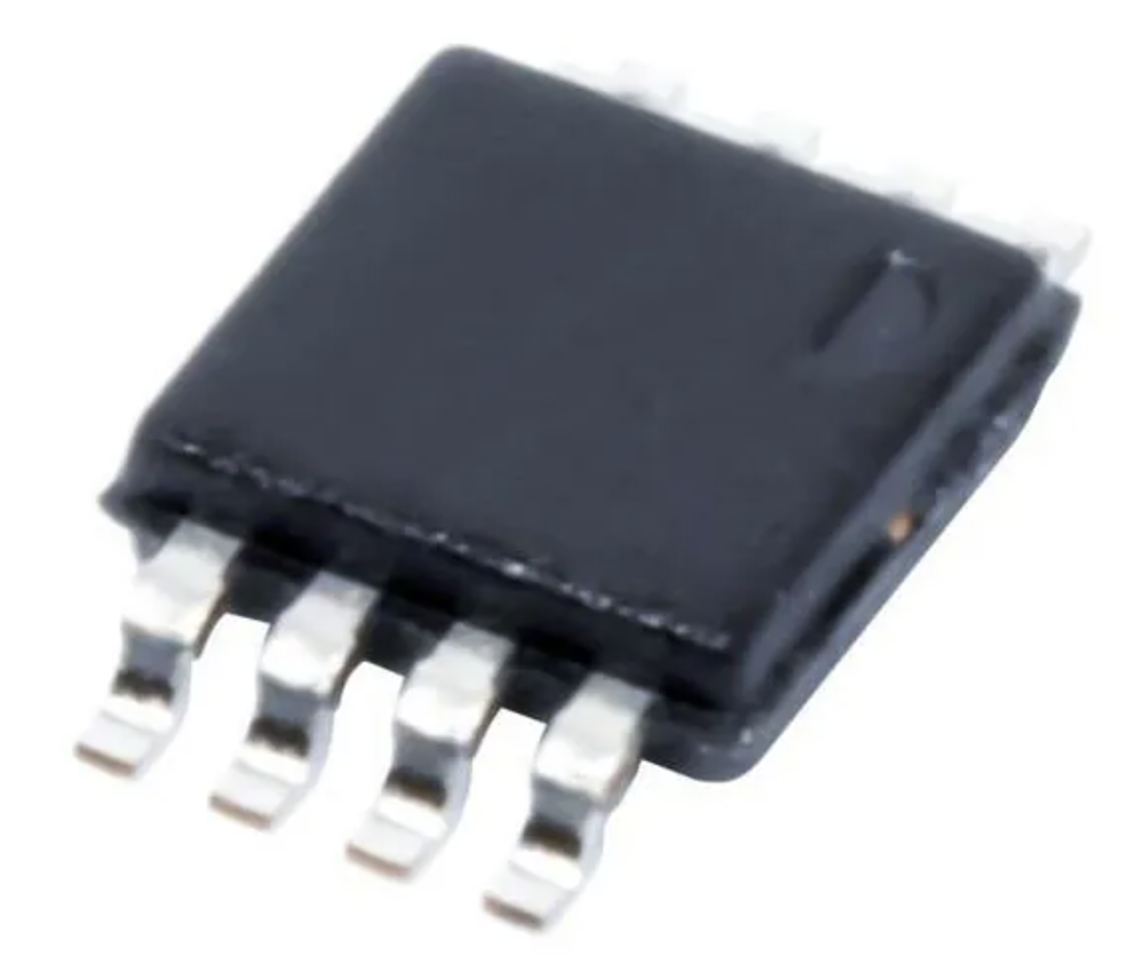
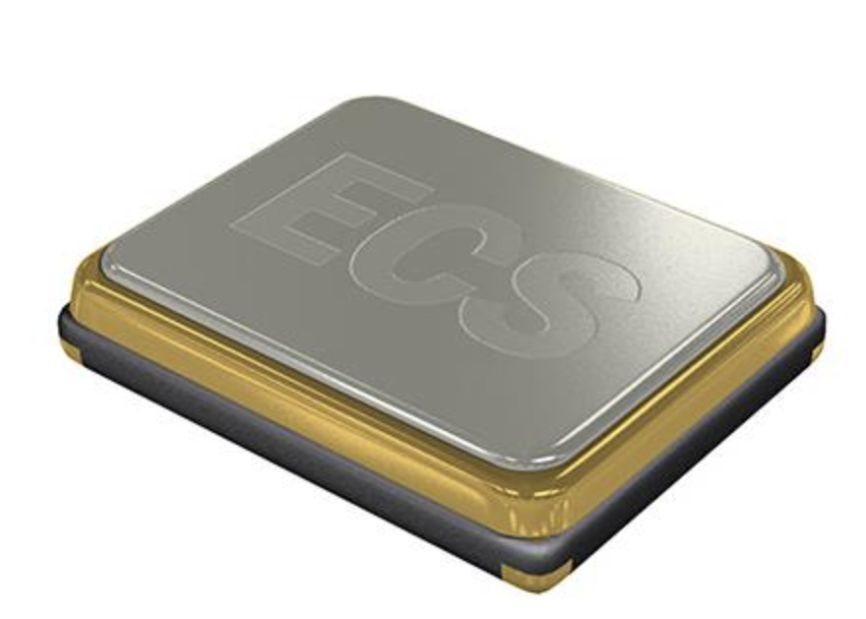
A TI PCM2903C based design
Audio Switch
USB Codec IC
3.3V Linear Reg
USB Connector
3.5mm Audio Jacks
Isolation Transformers
Logic Gate
Low Pass Filter
Oscillator

Slide 50
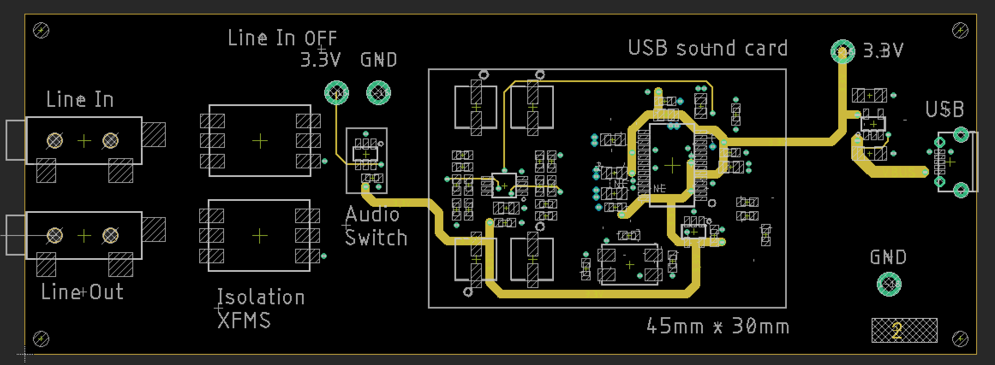
Layer 2 – Power Routing

Slide 51
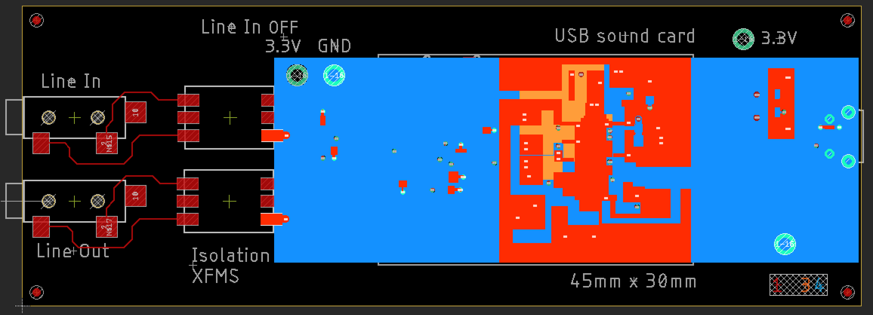
Layer 1, 3, 4: Ground Planes

Slide 52
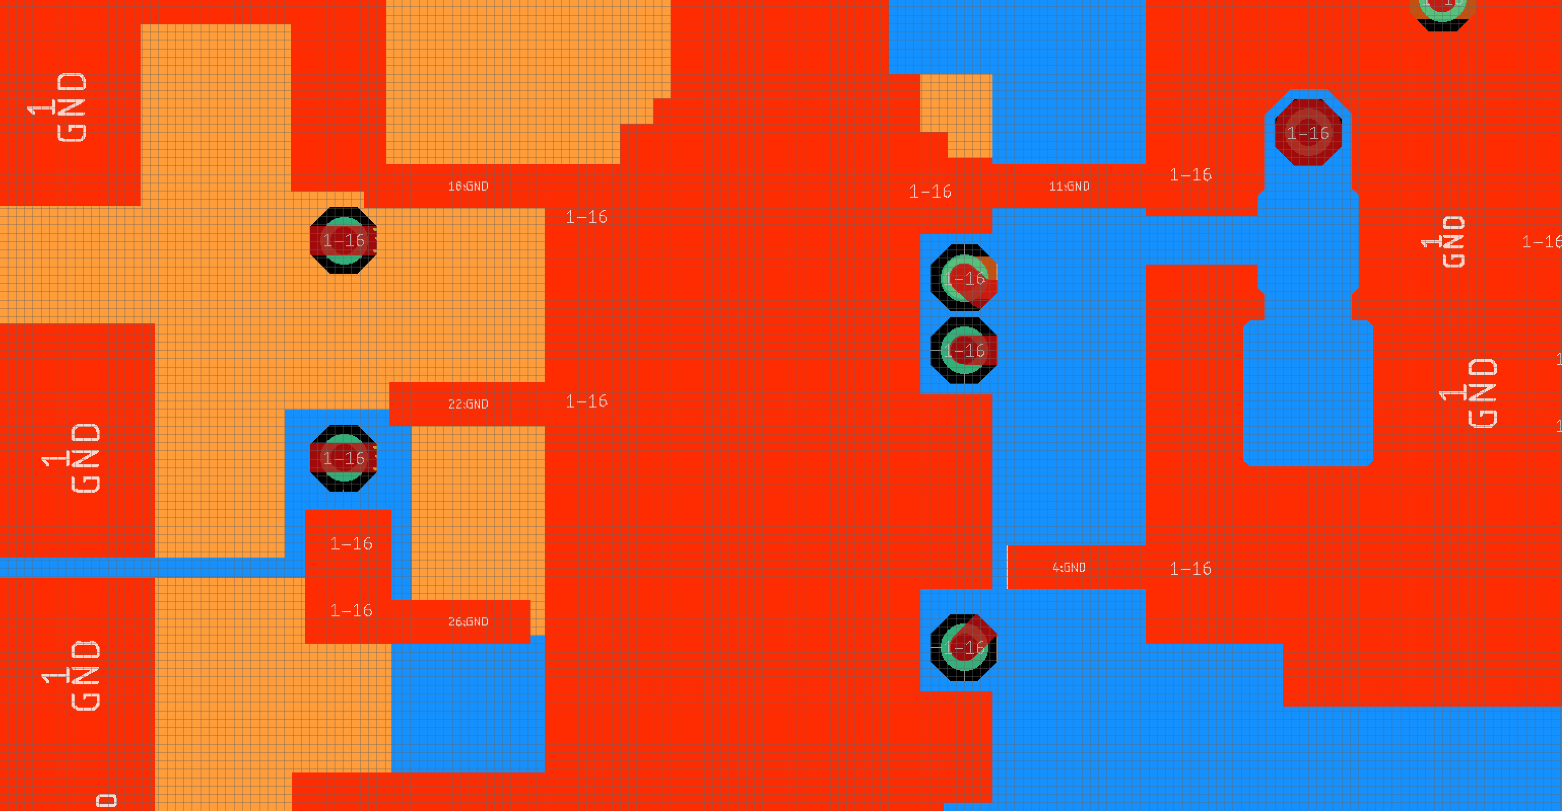
Layer 1, 3, 4: Ground Planes – Up close

Slide 53
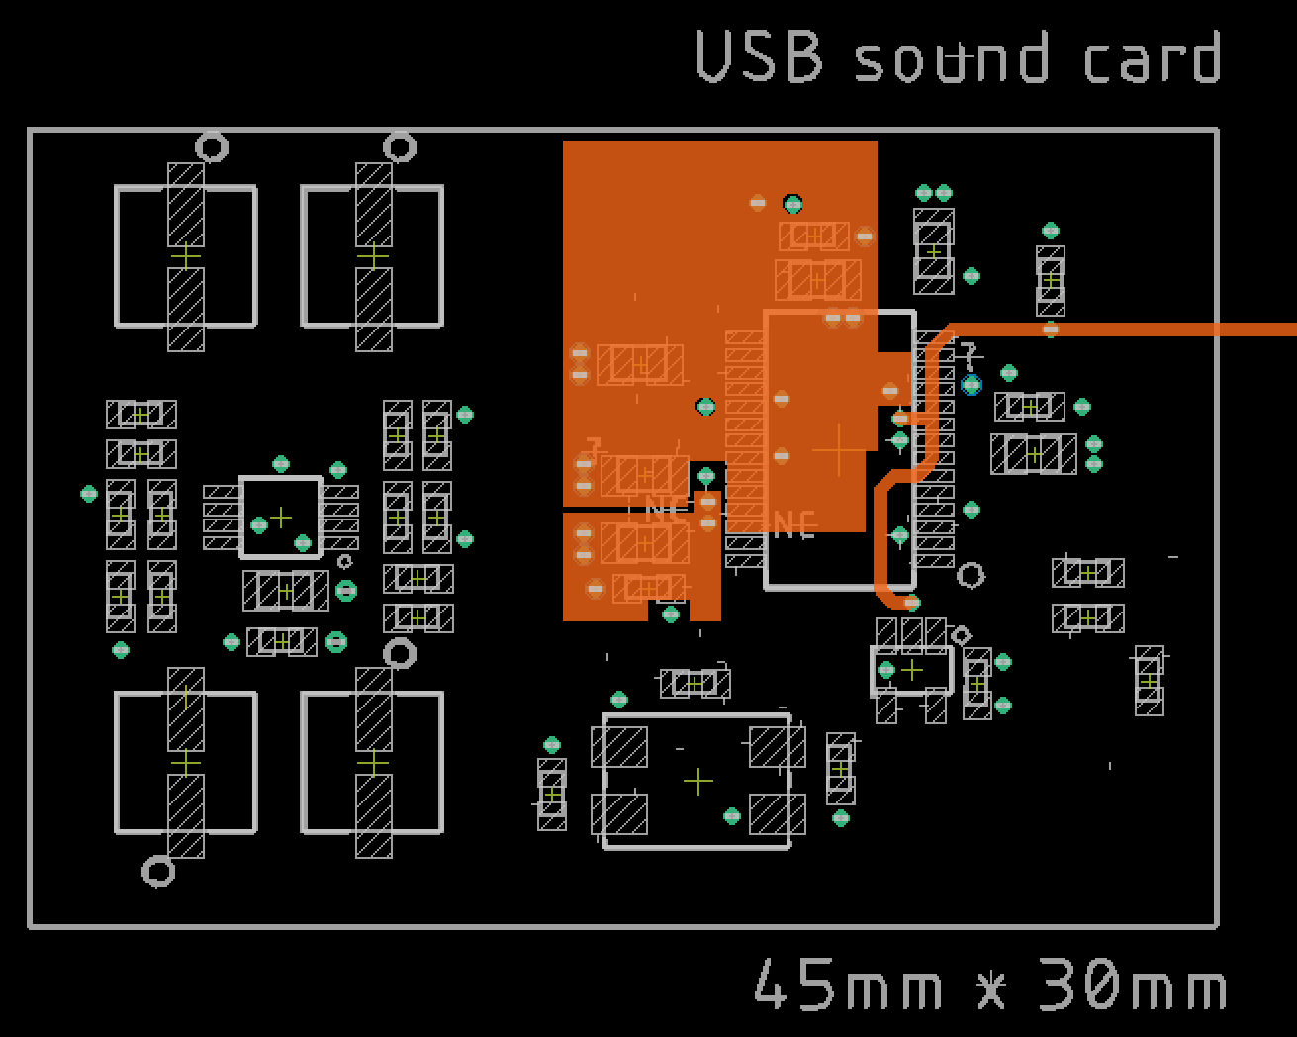
Layer 3: Ground Planes

Slide 54
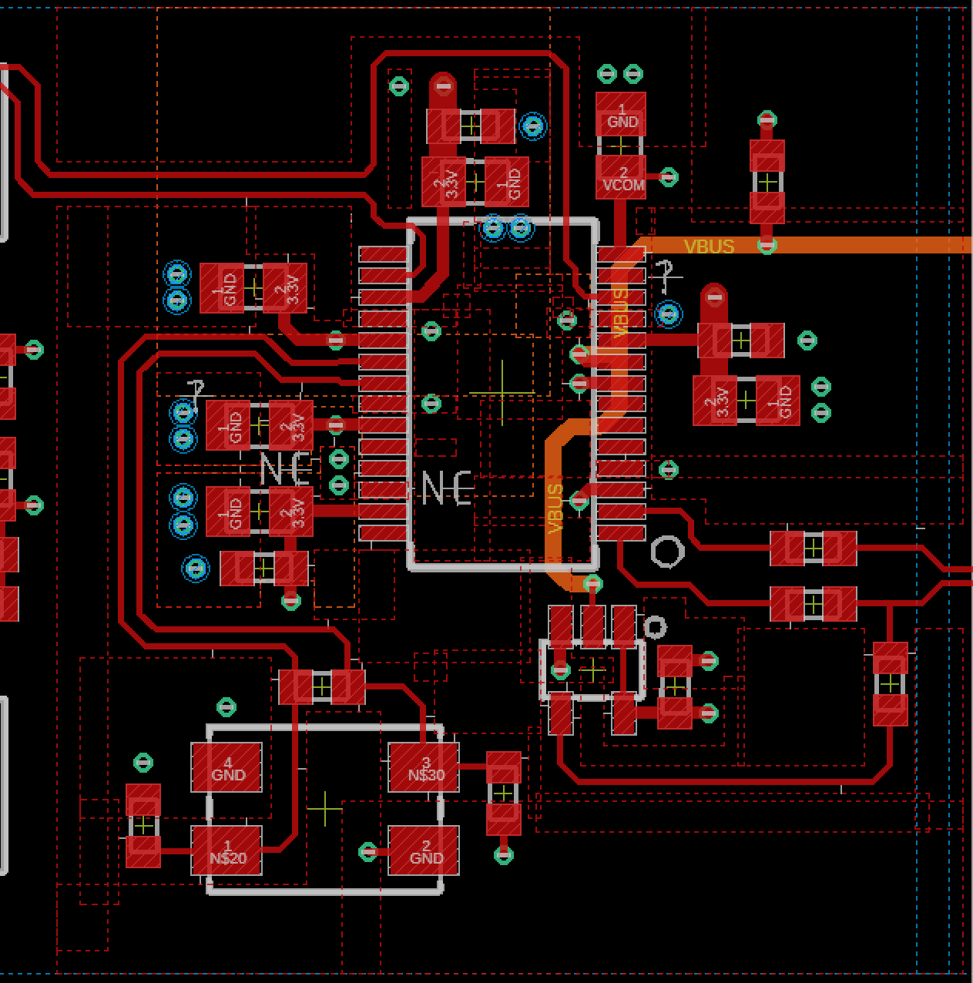
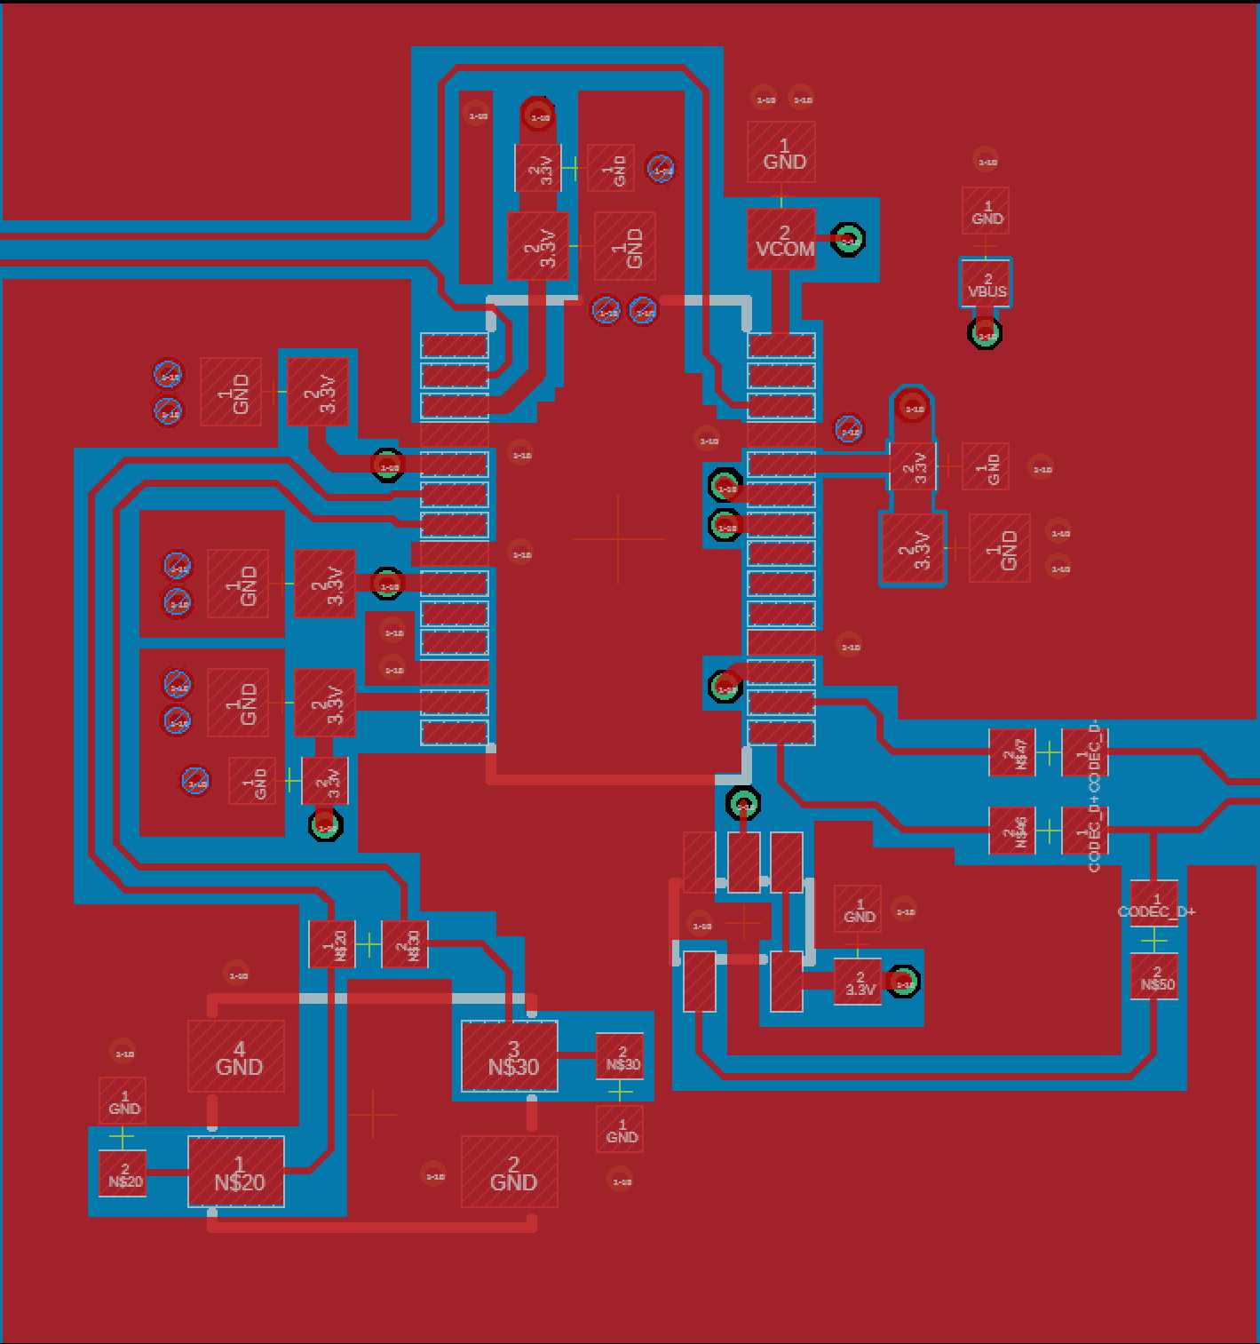
Layer Polygons
No GND connection to bottom layer

Slide 55
Codec

Slide 56
Low Pass Filter

Slide 57
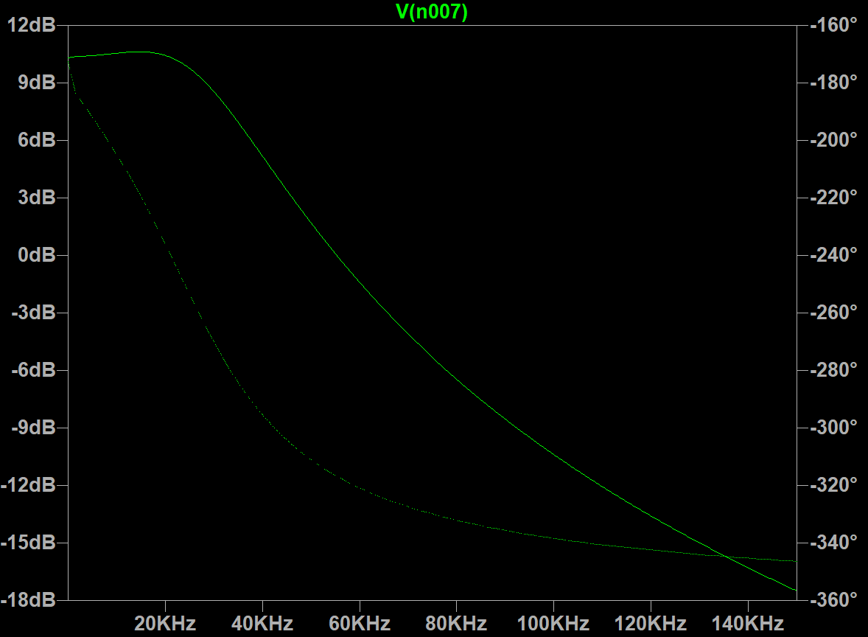

LTSpice filter simulation
20KHz
10dB
2Vpp
55KHz
0dB
0.6Vpp
100KHz
-10dB
0.09Vpp
Filter Response 10Hz – 150KHz
Filter Simulation

